Slide 1
Beyond Higher Education:
Resources and Partnerships for SIOs in Building Inclusive Societies
02/20/12

Slide 3
UN Academic Impact
Program of the Outreach Division of the UN Department of Public Information
Introduced by SG Ban Ki Moon in 2010 to engage HE in issues on the UN agenda
Ten universally accepted principles
One new project each year from each member related to one or more principle
More than 800 universities from 107 countries have become members
Any university in the world may participate in this program

Slide 4
UN Academic Impact
Academic Impact is informed by a commitment to support and advance ten basic principles:
1. A commitment to the principles inherent in the United Nations Charter as values that education seeks to promote and help fulfil;
2. A commitment to human rights, among them freedom of inquiry, opinion, and speech;
3. A commitment to educational opportunity for all people regardless of gender, race, religion or ethnicity;
4. A commitment to the opportunity for every interested individual to acquire the skills and knowledge necessary for the pursuit of higher education;

Slide 5
UN Academic Impact
5. A commitment to building capacity in higher education systems across the world;
6. A commitment to encouraging global citizenship through education;
7. A commitment to advancing peace and conflict resolution through education;
8. A commitment to addressing issues of poverty through education;
9. A commitment to promoting sustainability through education;
10. A commitment to promoting inter-cultural dialogue and understanding, and the “unlearning” of intolerance, through education.

Slide 6
UN Academic Impact
FDU-AYCHE STEERING COMMITTEE
Jonathan Bashi, Age 25, DRC, Central Africa, UniversitéProtestanteau Congo (DRC)
Plapa Koukpamou, Age 34, Togo, West Africa
Meena Murugappa, Age 17, Zambia, Southern Africa
Morrine Omolo, Age 23, Kenya, Eastern Africa
Lovans Owusu-Takyi, Age 30, Ghana
Avril Rua, Age 26, Kenya
http://globallearning.fdu.edu/AYCHE

Slide 7
UN Academic Impact
For More Information:
http://outreach.un.org/unai/
Ramu Damodaran
Chief, UN Academic Impact
damodaran@un.org

Slide 9
UN/DPI NGO Section
Association with the UN outreach and PR office
Responsible for disseminating information about the UN and its principles
Up to six UN HQ ground passes
Access to NGO Resource Center
Weekly NGO Briefings at UN HQ
Annual UN/DPI NGO Conference
Limited access to other UN conferences and events
About a dozen universities participate, but mostly in NY metro region

Slide 10
UN/DPI NGO Section
For More Information:
http://www.un.org/dpi/ngosection
Kelly Roberts
UN/DPO NGO Section Executive Board
keroberts@fordham.edu

Slide 12
ECOSOC Status
Full NGO status through UN Economic and Social Council
Participation in ECOSOC high-level segment
Participation in other UN meetings including the Commission for Social Development, Commission on the Status of Women, Commission on Sustainable Development
Opportunities to submit written statements and make oral presentations
Fifteen grounds passes (five at each UN HQ)
Very demanding application process
Next deadline for new applications is 31 May 2012

Slide 13
ECOSOC Status
For More Information:
http://csonet.org/
Andrei Abramov
Chief, NGO Branch, DESA
1-212-963-8652 (Irma Perez)

Slide 15
CoNGO
Conference of NGOS in Consultative Relations with the United Nations
ECOSOC status required for full membership, DPI status for associate membership
Serves as advocate for NGOs within UN system
Active substantive committees on various issues (e.g., human rights, sustainable development, education, health, women, youth, etc.)
Semi-Annual Civil Society Forums (NY and Geneva)
Tw0 university members (one full, one associate)

Slide 16
CoNGO
For More Information:
http://www.ngocongo.org/
Jo Anne Murphy
CoNGO Executive Board
Jo-Anne_Murphy@fdu.edu

Slide 18
UNESCO
HE Priorities: research (all areas), capacity building, access issues, research, teacher training, and inter-university cooperation
715 UNESCO Chairs/69 UNITWIN Networks
830 HE institutions in 130 countries
Shifting emphasis from Chairs to Networks
Any university or group may apply to UNESCO but highly advisable to consult with program officer
April 30 deadline
No funding from UNESCO but opportunities to leverage funding through application process

Slide 19
UNESCO
For More Information:
http://www.unesco.org/new/en/education/themes/strengthening-education-systems/higher-education/

Slide 21
Alliance of Civilizations
Initiative of UN SG to improve understanding and cooperative relations among nations and peoples across cultures and religions
Alliance Research Network (21 institutions/networks of institutions and research centers )
UNITWIN on Media and Information Literacy and Intercultural Dialogue
UNAOC Forum (February 28-29, 2013)
World Interfaith Harmony Week (February 1-7)
World Day for Cultural Diversity for Dialogue and Development (May 21)

Slide 22
Alliance of Civilizations
For More Information:
http://www.unaoc.org/
Jean-Christophe Bas
Senior Advisor, Strategic Development
jeancb@unops.org

Slide 24
UN Global Compact’s Ten Universal Principles
For Responsible Business
HUMAN RIGHTS
1: Support and respect the protection of internationally proclaimed human rights.
2: Ensure the company is not complicit in human rights abuses.
LABOUR STANDARDS
3: Uphold the freedom of association and the effective recognition of the right to
collective bargaining.
4: Eliminate all forms of forced and compulsory labour.
5: Seek the effective abolition of child labour.
6: Eliminate discrimination with respect to employment and occupation.
ENVIRONMENT
7: Support a precautionary approach to environmental challenges.
8: Undertake initiatives to promote greater environmental responsibility.
9: Encourage the development and diffusion of environmentally friendly technologies.
ANTI-CORRUPTION
10: Work against all forms of corruption, including extortion and bribery.
Notes:
MITCH: Introduction of UNGC Principles

Slide 25
UNGC Academic Working Group: Mission, Vision & Objectives
Mission:
To promote the adoption and implementation of the UNGC’s Ten Principles holistically by higher education institutions, through the creation and dissemination of applicable tools.
Vision:
To create a context in which higher educational institutions are able to build upon their awareness of their social responsibilities and have the necessary tools to fulfill these obligations.
Objectives:
❒ Develop guidelines for academic institutions to implement the UNGC Principles in their goals, strategies, and operations.
❒ Build upon awareness within the global academic community regarding its social responsibility and available tools for implementation and self-assessment.
❒ Evaluate the sustainability of the guidelines and highlight best practices.
UNGC Academic Working Group
Notes:
MITCH: Role of the Working Group – its Mission, etc.

Slide 26
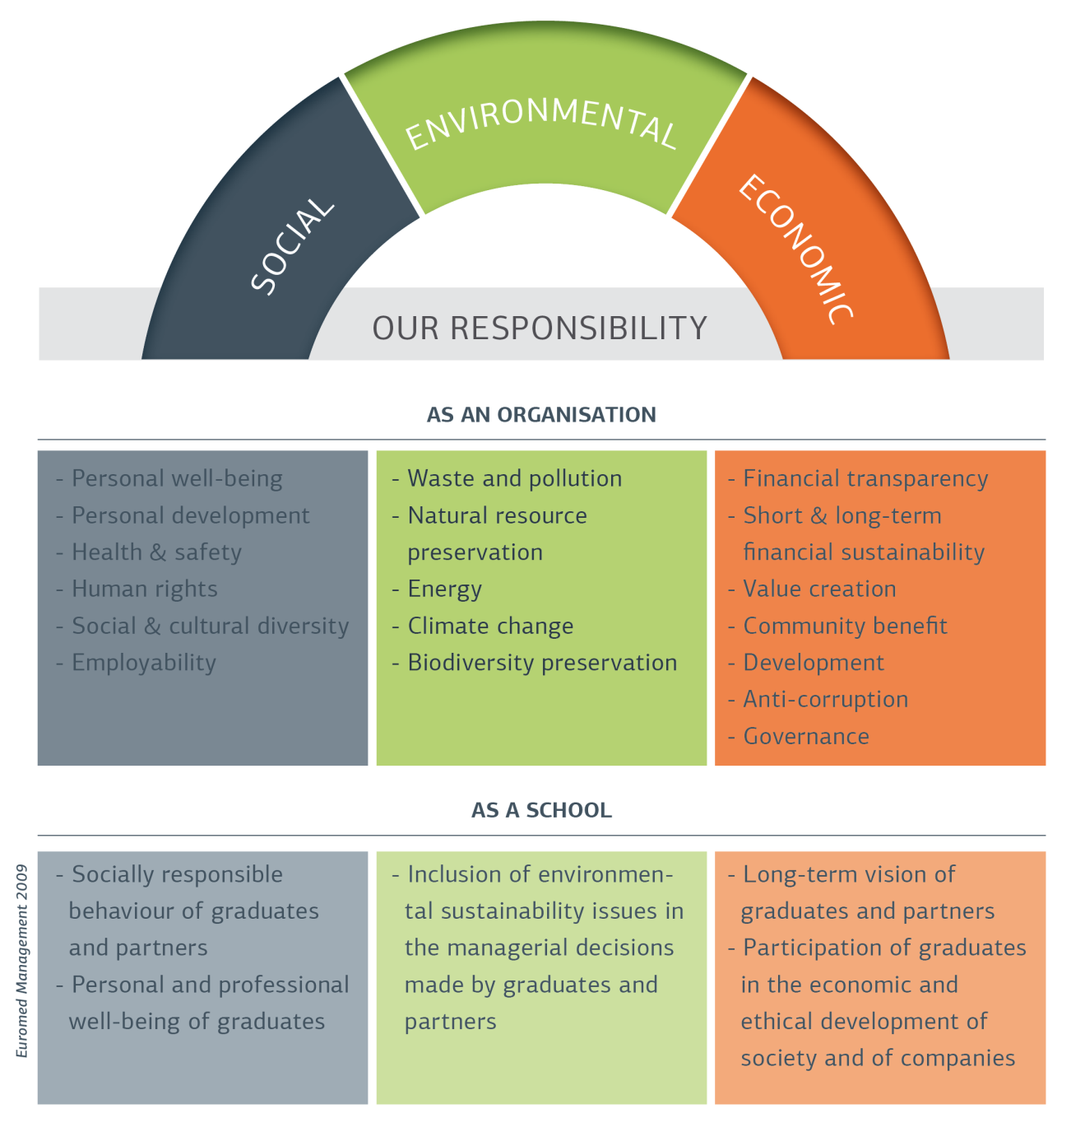
CSR In Higher Education:
The Scope of Our
Responsibility

Slide 27
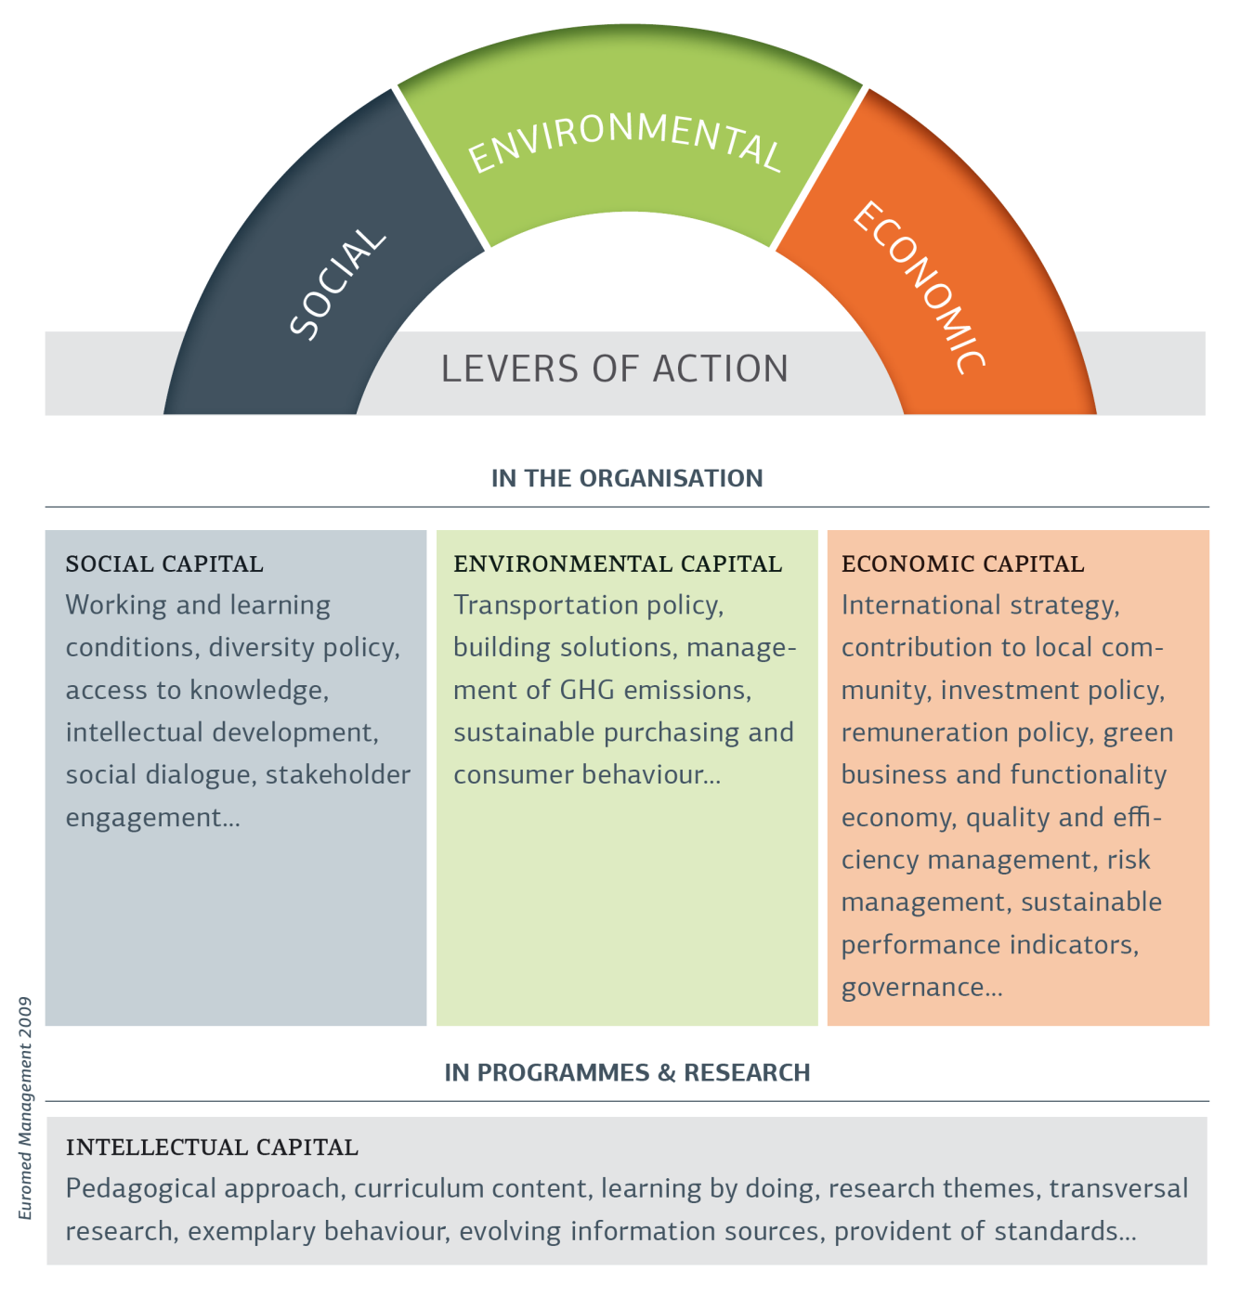
CSR In Higher Education:
The Scope of Our
Responsibility

Slide 28
UN Global Compact
For More Information:
http://www.unglobalcompact.org/
Mitch Leventhal
Senior Advisor on Academic Affairs, UNGC
mitch.leventhal@suny.edu

Slide 29
Contacts
Mitch Leventhal
Vice Chancellor for Global Affairs
State University of New York (SUNY) System
Mitch.Leventhal@suny.edu
Jason Scorza
Vice Provost for International Education
Fairleigh Dickinson University
Scorza@fdu.edu

