Slide 1
Connecting Campus Internationalization Priorities and Global Challenges
Danny Damron, Utah Valley University
Darina Lapadatu, Kennesaw State University
Meredith McQuaid, University of Minnesota
Daniel J. Paracka, Kennesaw State University

Slide 2
Defining Internationalization
Global Learning
  the knowledge, skills, and attitudes that students acquire through a variety of experiences that enable them to understand world cultures and events; analyze global systems; appreciate cultural differences; and apply this knowledge and appreciation to their lives as citizens and workers
  - Olson, Green, and Hill 2006, v
Internationalization
    the process by which institutions foster global learning
    - Olson, Green, and Hill 2006, v
  the process of integrating international and multicultural perspectives and experiences into the learning, discovery and engagement mission of higher education
  - Knight, 1994

Slide 3
Assessing Internationalization Efforts
Through student global learning outcomes
  Investigate
  Recognize
  Communicate
  Translate
Through coalition building with faculty
Through promoting stakeholder buy-in of the university’s internationalization strategic plans
Notes:
through student global learning outcomes (Stearns, 2009).
Students demonstrate successful acquisition of global learning by demonstrating their ability to
investigate the world beyond their immediate environment,
recognize their own and others’ perspectives,
communicate their ideas effectively with diverse audiences, and
translate their ideas and findings into appropriate actions to improve conditions
(emphasis added, EdSteps, Global Competency Matrix).
Through coalition building with faculty
Through promoting stakeholder (both inside and outside the university) buy-in for the university’s internationalization strategic plans

Slide 4

Global Spotlight/Country Study Program
U of Minnesota: Global Spotlight
Kennesaw State U: Country Study Program
Utah Valley U: Global Spotlight
Notes:
Global Spotlight/Country Study Program as a tool for connecting campus internationalization priorities and global challenges students will encounter.
Given the place many international offices occupy on campus – outside traditional departments but tasked with crossing disciplinary lines, international offices can provide “substantive, developmentally appropriate engagement over time with the world’s complexities” in ways that supplement and support faculty, department, and college internationalization efforts. To the extent that international office efforts are intentional and strategic they can help build campus and curricular internationalization. The Global Spotlight/Country Study Program provides a way to achieve those internationalization imperatives.

Slide 5
Global Spotlight at the University of Minnesota
Engaging Faculty in International Scholarship
Meredith McQuaid
Associate Vice President and Dean
International Programs

Slide 6

U of M Global Spotlight
Biennial focus on a region of the world and a pressing global issue.
2009-10: Africa and Water in the World
2010-12: Latin America & the Caribbean and the Impact of Urbanization
Notes:
Plan and support events related to the themes
Research grants for faculty, graduate students

Slide 7
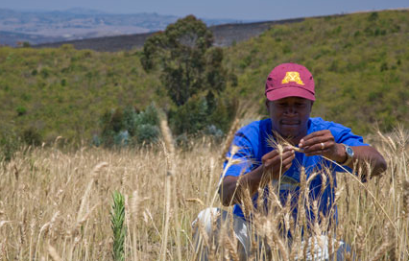
Goals of the Program
Increase international
scholarly activities of
faculty
Increase understanding
of a region of the world
and a pressing world
issue
Learn where the
University is around the world
and what we’re doing there
Notes:
highlight existing strengths of the University
build on cross-border and cross-disciplinary relationships
educate and inform the University and local community
identify and provide funding for targeted research and other scholarly initiatives
increase the University’s visibility and stature around the world

Slide 8
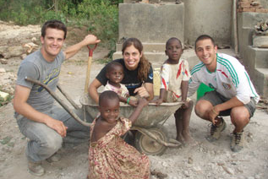
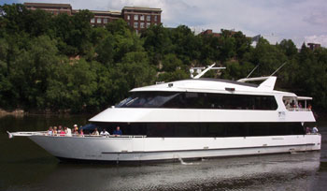
Highlights of 1st Biennium
13 monthly “2Tuesday” presentations
31 events co-sponsored with campus and community partners
Notes:
13 monthly “2Tuesday” presentations
Engineers Without Borders Project in Uganda
Design for the Planet’s Poor
31 events co-sponsored with campus and community partners
Symposium on literacy in Africa with Books for Africa
Welcome Week: Taking Responsibility for a Great River

Slide 9
Research Grants
Support faculty and graduate student research
Strengthen research partnerships with institutions abroad
First round: $1.25 million awarded
  Major International Research Grants (4)
  International Collaborative Seed Grants (9)
  Doctoral Fellowships for Int’l Research (4)
  Int’l Pre-Dissertation & Small Grants Awards (10)

Slide 10


Annual Country
Study Program
The Country Study Program provides audiences with a rich, complex, interconnected sense of place and community. For 28 years, the program has enhanced cross-cultural understanding among Kennesaw State University’s students, faculty, staff along with our local and global communities. With over 30 events annually, students learn about the country from diverse perspectives.
Faculty involvement in planning and implementation is extensive. It results in new research projects, new courses and curriculum, new education abroad programs, and new global partners.
Notes:
Logos from recent Year of Programs at KSU designed by KSU students, partner university students, and community partners.

Slide 11

Major Program Elements
Local Community Partners & Overseas Partners
Grant Agencies & Sponsors
Faculty Learning Community & Development Seminar
Funded Course Modules / new or adapted Courses tied to lecture series
Academic Conference
Special Issue of Journal of Global Initiatives
Lecture Series
Year of Day
Art Exhibits, Performances, Film Festival
Bibliographies & Library Development
Student Involvement & Study Abroad
Program Promotion/Publicity
Notes:
Planning starts more than a year in advance and consists of monthly meetings. For the most involved faculty this results in a 2 year commitment. Most events involve co-sponsorship with different academic departments. Each year, we focus on a different world region. Therefore in 4-5 years, undergraduates can learn about specific countries in all major regions. Our area studies programs are actively involved in supporting the program especially when the country of study is from their regions of expertise. The many different types of programs allow us to both celebrate the country and its successes as well as address challenges and controversies.

Slide 12
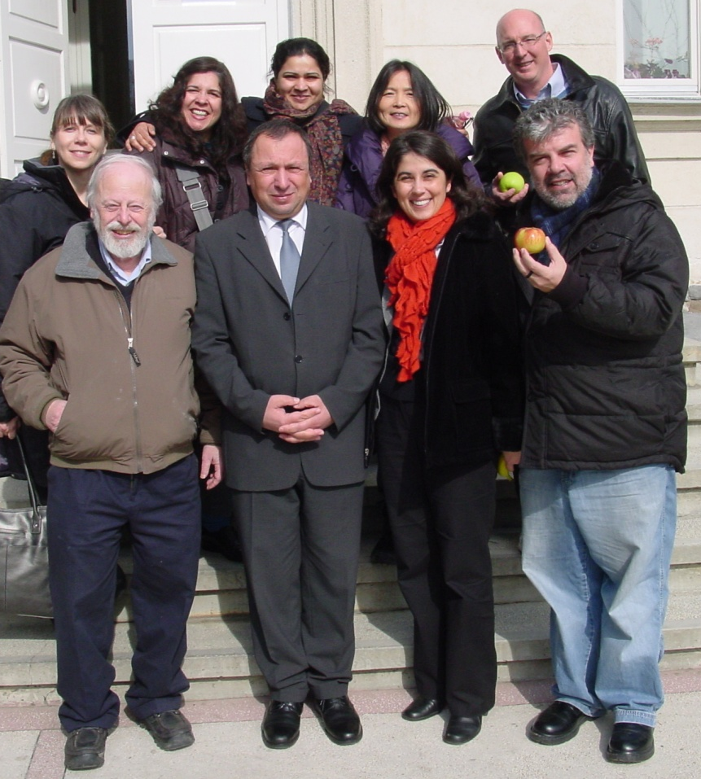
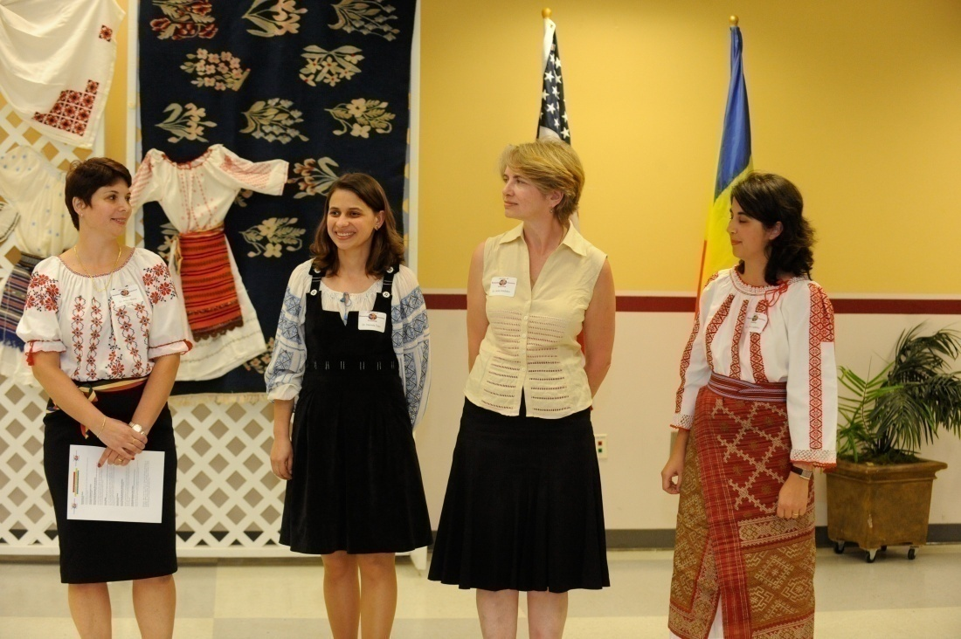
Faculty Leadership a Key Component
Funded faculty development seminars strengthen research opportunities, interdisciplinary collaboration, and international partnerships.
KSU’S Romanian faculty took an active
leadership role in program planning and implementation.

Slide 13
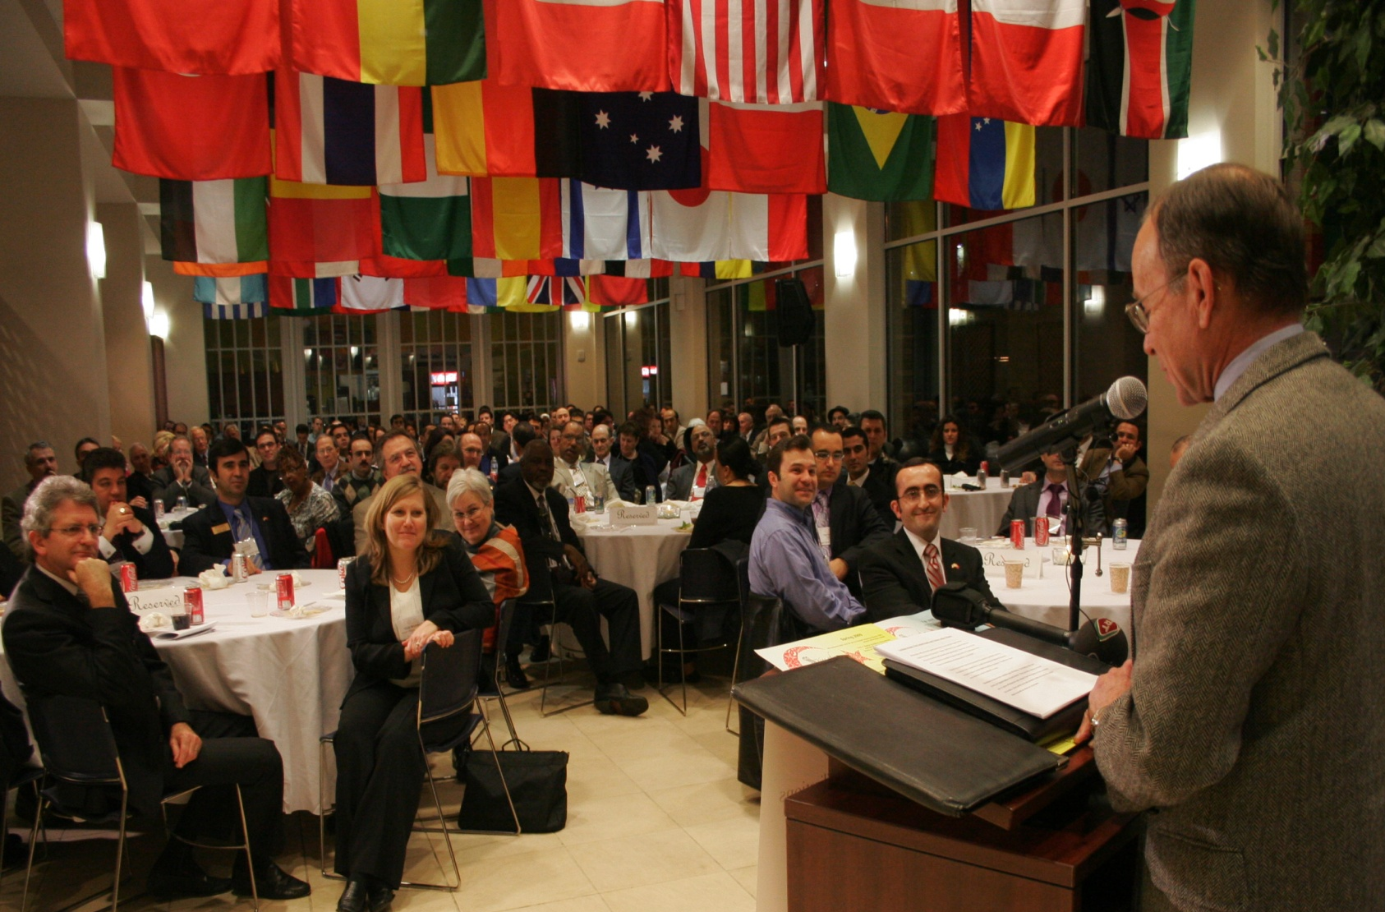
Conferences Strengthen Research Networks & Community Partnerships
“Alliance of Civilizations” conference co-sponsored with United Nations.
Notes:
Partners in KSU’s Year of Kenya (2006-2007) conference on “The Role of the Kenyan Diaspora in Kenya’s Development” included the Association of Kenyan Professionals in Atlanta (AKPA), Kenyan Development Network Consortium (KDNC), the Embassy of Kenya, Foundation for the Empowerment of Africans, Kenyan Community Abroad (KCA), Global Literacy Project (GLP), and the Kenyan Christian Fellowship in America (KCFA). Over 700 people from the local Kenyan community as well as from other parts of the United States and Kenya attended, including the Kenyan Ambassador to the United States, Peter Ogego, and the Minister of Finance, Amos Kimunya, who’s keynote address provided an overview of Kenya’s economic health, fiscal policies, and the impact of remittances.

Slide 14


Exhibits & Performances Capture Attention
Contemporary works of Chen Zhen received a National Endowment for the Arts grant.
Theatre department performed (at KSU and in China) an original play based on novel Journey to the West.
Notes:
Funding Agencies & Original Creative Activity

Slide 15
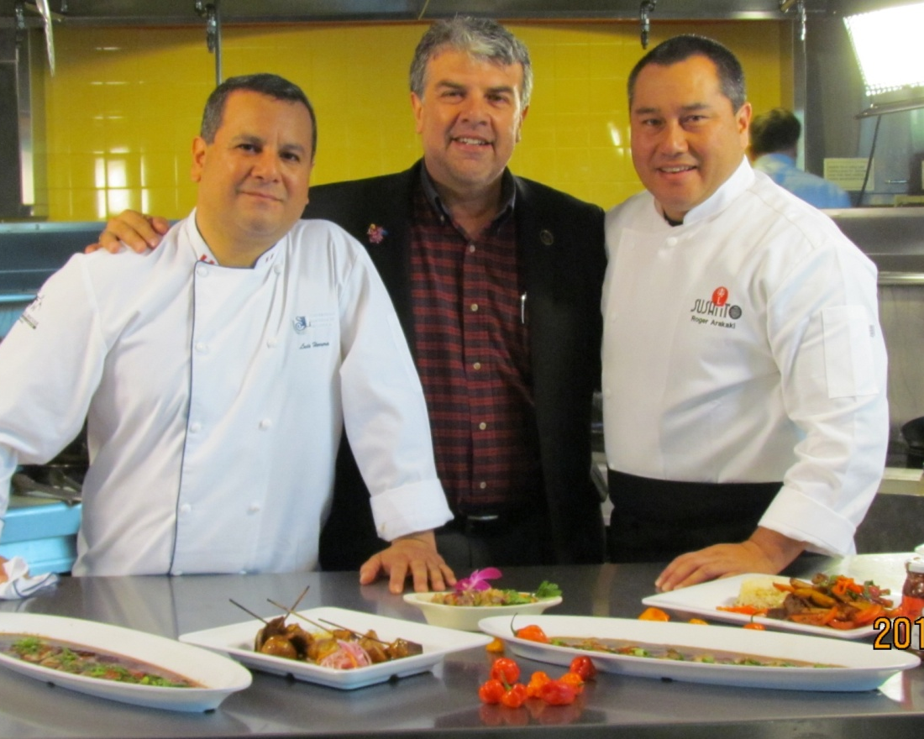
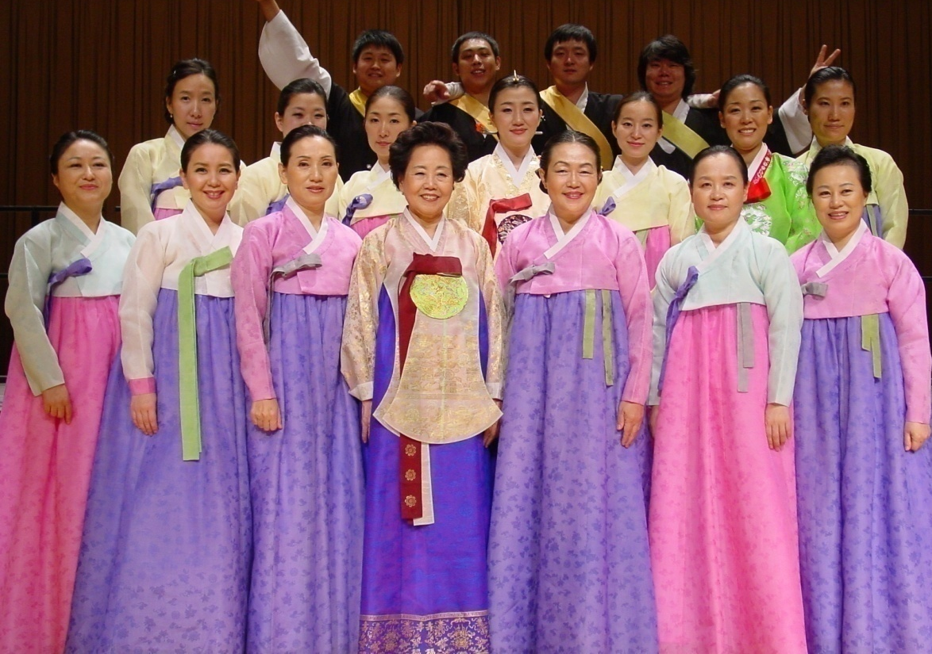
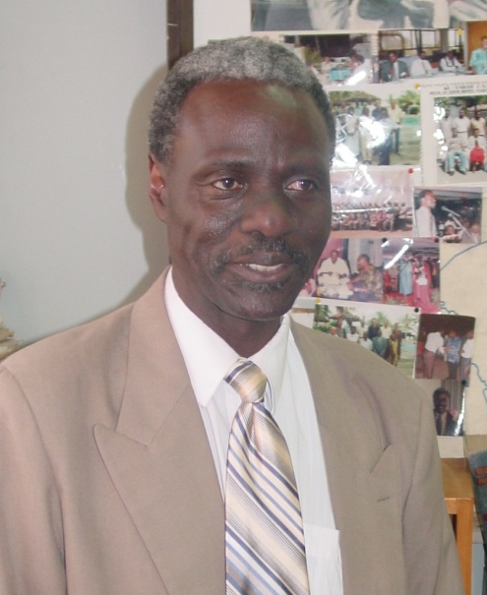
Artists-in-Residence
Share Expertise
Notes:
Artists-in-Residence, Funded by S. Korea Gov’t

Slide 16
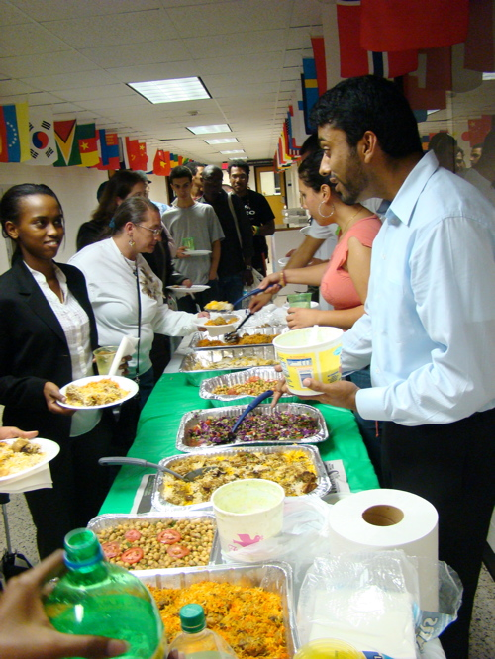
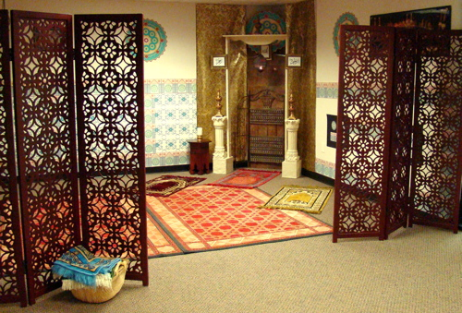
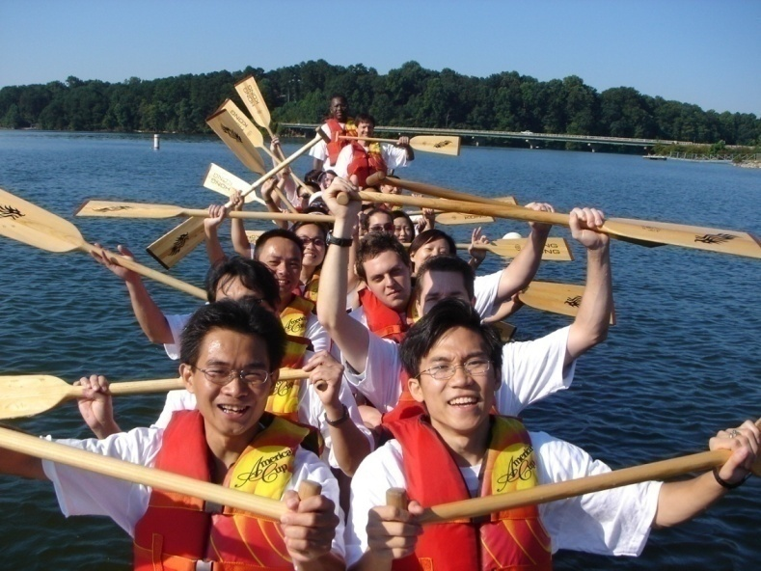
Student Engagement:
Iftaar Prayer Room and breaking the fast during Ramadan Dragon Boat Racing
Notes:
Student Engagement & Cross-Cultural Sensitivity - Dragon Boat racing during the Year of China (2005-2006) – KSU now participates annually in this friendly competition. The team includes both U.S. and Chinese students and faculty.

Slide 17
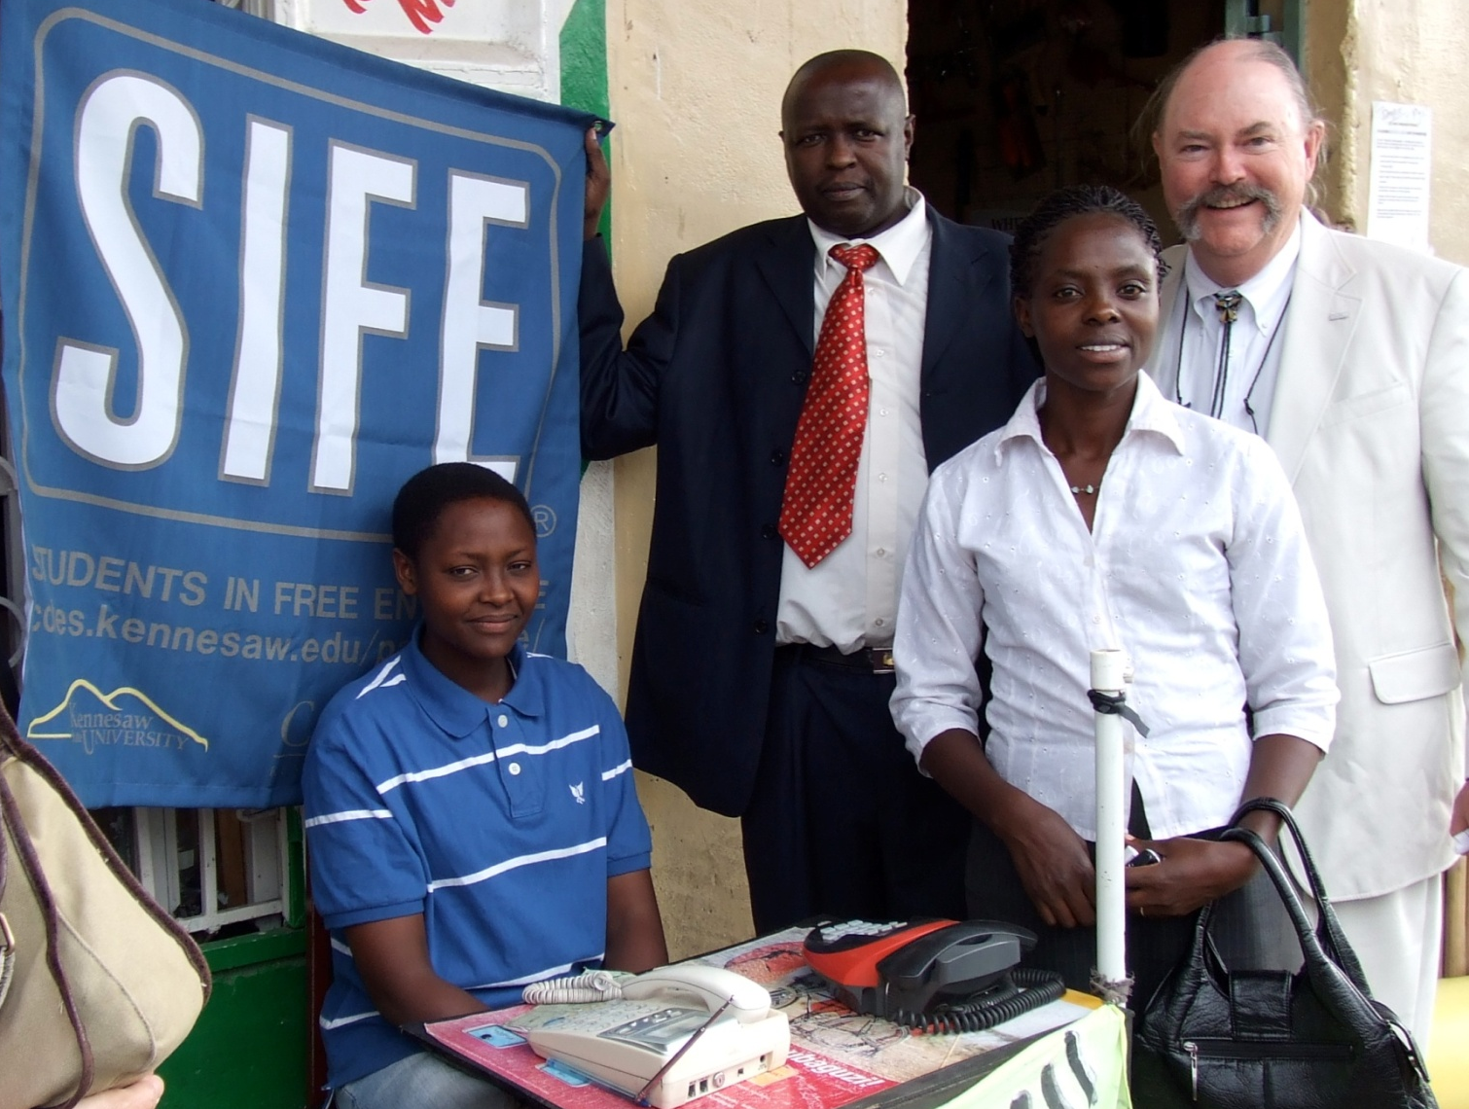
Follow-up activities: KSU’s Students in Free Enterprise (SIFE) team invested funds with Kiva.org in small businesses in Kenya, Uganda and Tanzania.
Notes:
Student Engagement and International Partners

Slide 18
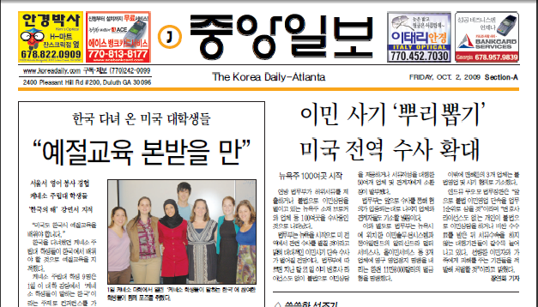
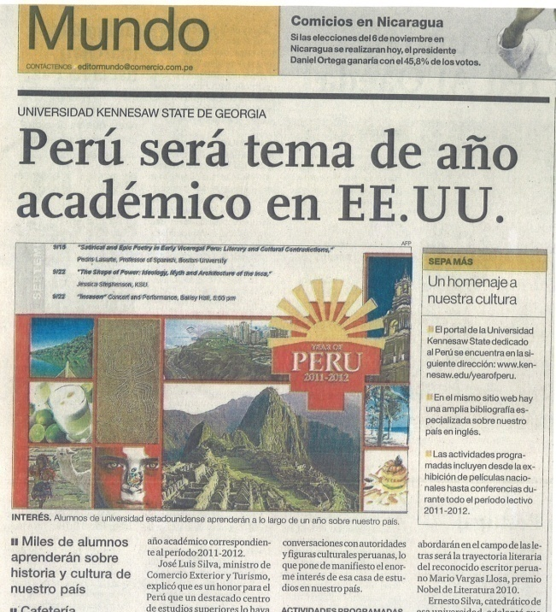
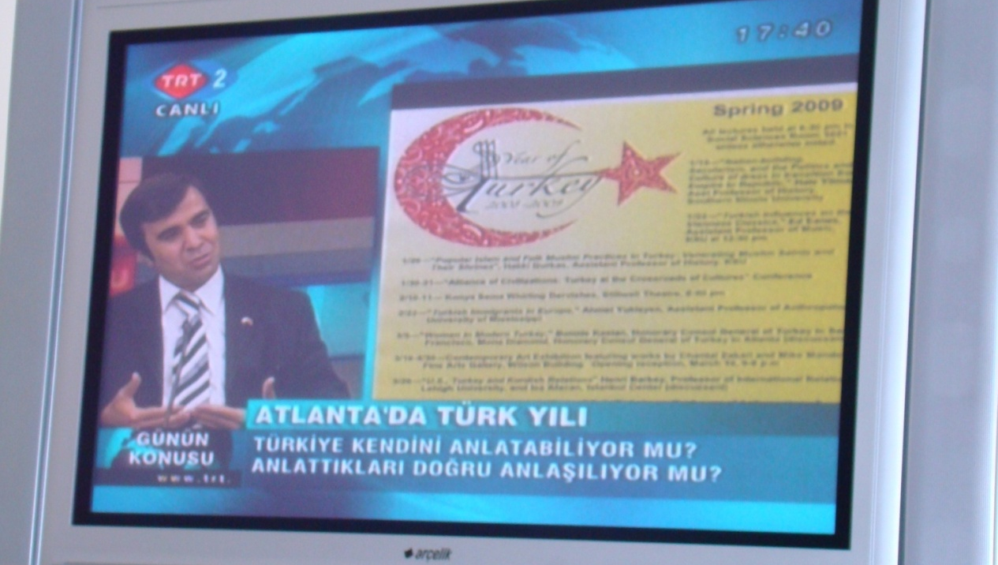
Promotion & Publicity:
The ACSP featured in local Atlanta area newspapers, major national newspapers and
global television networks.
EX: Year of Turkey - more than 20 TV interviews in Turkey including CNN-Turk, TRT (Turkish Radio and Television) STV (Samanyolu TV), and Mehtap TV.
Notes:
Local News Coverage

Slide 19
Global Spotlight at Utah Valley University
Preparing Globally Competent Citizens
Danny Damron
Director
International Center

Slide 20
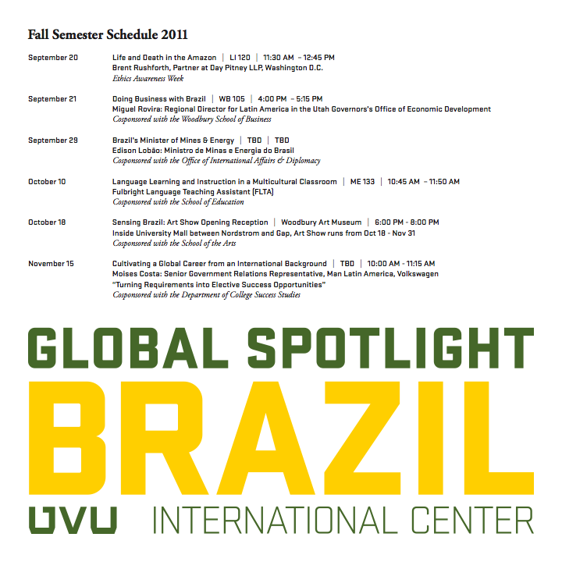
2009-2010 AY: Central Asia
2010-2011 AY: China
2011-2012 AY: Brazil
2012-2013 AY: Eurasia

Slide 21

The Basics
Faculty Study Seminar
Academic year-long
General Education Focus
Interdisciplinary
Study Abroad Development
Cultural Outreach
Book of the Semester
International Cinema

Slide 22

Governance and Decision-making
Supporting campus stakeholders-campus internationalization priorities
Connecting country selection with faculty/administration buy-in
Balancing academic complexity with GE-like accessibility
Collaboration with community partners
Notes:
Budget: describe the initial fundraising process and the ways it promoted buy-in

Slide 23

Steps
Forward
Curriculum/Campus integration
“JumpStart” program development
Curriculum internationalization grants
Study Abroad/International Internship development grants
Faculty professional development grants
Student intensive language study grants
Assessment

Slide 24
Lessons Learned
Faculty can become real partners once engaged.
Everyone appreciates need for central source of information.
Shared interests do not create synergy.
Global Spotlight was a way to draw attention to our office.
Engagement with students, community declined.
Evaluating outcomes is difficult.

Slide 25
Lessons Learned
Evolution of Program (Institutional Support, Strategic Planning, Budgeting)
Start Early (especially when seeking grants & government support)
Selection process & criteria
Making Connections, Building Community (Local and Global) (Interdisciplinary Collaboration and Intercultural Communication)(reinforcing/interconnected elements)
Buy-In: Colleges, Departments, Faculty, Staff, and Students (co-sponsorship/ownership)
Faculty Engagement and incentives for Teaching, Research & Service aspects (commitment)
Balancing Sensitive Topics with Appreciation for Cultural Differences (Levels of engagement and sensitivity)(Different events – different target audiences)
Assessment, Documentation, Promotion and Symbolic Value

Slide 26
Lessons Learned
Planning committee – use existing international center board when possible, supplement to achieve broad campus representation if needed
Start small/use own funds + small contribution from schools/colleges to create value
To achieve buy-in and a “ready-made” audience, solicit co-sponsorship, even if in name only, of all events
Advertise early and often, social media, on and off campus, etc.
Pre- and post- event gathering w/ privileged access for donors, friends of international education, stakeholders, etc.
Create a year end “product” summarizing activities
Publicity – let campus know what has been done and what is coming
Work with faculty to identify ways to support their scholarship, teaching, and service priorities

