Slide 1
The Matariki Network of Universities – A small but beautiful view of partnering for a better world www.international.uwa.edu.au/aiea-conference-2012
02/22/12

Slide 2
The Matariki Network of Universities – A small but beautiful view of partnering for a better world
Kelly Smith, Director, International Centre, The University of Western Australia (Chair)
Speakers
Professor Sarah Todd, Pro Vice Chancellor International, The University of Otago, New Zealand
Professor Jane Long, Pro Vice Chancellor (Education), The University of Western Australia
Professor Lindsay Whaley, Associate Provost of International Affairs, Dartmouth College, USA

Slide 3
The Matariki Network Members
The Matariki Network of Universities was formed in 2010
Membership comprises:
Dartmouth College (USA),
Durham University (England),
Eberhard Karls University of Tübingen (Germany)
Queen’s University (Canada),
The University of Western Australia (Australia),
University of Otago (New Zealand),
Uppsala University (Sweden)

Slide 4
The Matariki Network Founding Principals
Excellence in research and education take equal priority
Leading researchers are directly engaged in all aspects of teaching
Education is considered as a combination of academic learning and personal growth in a diverse community
Small to medium in size
Based outside the capital cities of their respective countries
Have a leading role in their local communities
The term Matariki is the New Zealand Maori word for the Seven Sisters or Pleiades constellation - recognises Otago’s lead role, the number of members and also the network’s commitment to indigenous knowledge

Slide 5
Speaker One
Professor Sarah Todd, Pro Vice Chancellor International, The University of Otago, New Zealand

Slide 6
The Matariki Network of Universities “A network perspective”
Professor Sarah Todd
Pro-Vice-Chancellor (International)

Slide 7
Defining a “network”
... the concept of networks has been used to describe a range of nonmarket, non-hierarchy forms of organizational governance, including, but not limited to, joint ventures, partial equity, licenses, cooperative R&D, consortia, franchises, clans and the like
Koza & Lewin 1999 Organizational Science 10(5):638-53
..networks arise from the social interactions of collective interactions of multiple parties
...generally been defined to include the multiplicity of ways in which at least two firms...may be organized to cooperate for mutual benefit

Slide 8
Defining a network (2)
An organisational network can be thought of consisting of a number of positions or nodes, occupied by firms, business units, universities, governments, customers or other actors, and links or interactions between these nodes.
Tidd et al (1997)
...set of nodes (persons, organisations) linked by a set of social relationships (friendship, funds transfer, overlapping membership) of a specific type
Laumann,Galaskiewicz, Marsden 1978

Slide 9
Alliances vs Networks?
...voluntary arrangements between firms involving exchange, sharing, or co-development of products, technologies or services
Johannisson 1990
Alliance networks emerge when exchange conditions favour asset specificity, demand uncertainty, task complexity and frequency

Slide 10
Key concepts
Social theory influence:
status, power & influence, trust, centrality, social capital & performance
TRUST
The adoption of a belief by one party in a relationship that the other party will not act against his or her interests, where this belief is held without undue doubt or suspicion and in the absence of detailed information about the actions of that other party.
‘trust development chain’
A relationship will not develop without the growth of trust, but willingness to continue with the relationship depends upon more than the existence of trust. The relationship must deliver something of value to the parties involved as well as being simply an arena for trust

Slide 11
Key Concepts (2)
INTERDEPENDENCE
the probability of a new alliance between specific organisations increases with their interdependence and also with their prior mutual alliances, common third parties, and joint centrality in the alliance network

Slide 12
MNU – a case study
7 universities, strong history of research & academic learning, shared emphasis on student life/services
Some pre-existing bilateral relationships
Activities across a range of areas
Library benchmarking
Annual research workshop
Student Services Forum
Peace & Conflict Studies curriculum workshop
Student & staff exchange
Secretariat, rotating chair, shared hosting of meetings
“User-pays” basis

Slide 13
Primary benefits
Sharing of best practice/benchmarking
Reputational/branding
Research & teaching collaboration
Internationalisation of staff & students

Slide 14
Challenges
Communication
Funding
Understanding & mapping nature of collaborations
Institutional & international differences
Structures, programmes, calendars, dissemination of information across institutions

Slide 15
Summary
Trust √
Interdependence √
Non-hierarchical √
Co-operation for mutual benefit √
Overlapping membership √

Slide 16
Speaker Two
Professor Jane Long, Pro Vice Chancellor (Education), The University of Western Australia

Slide 17
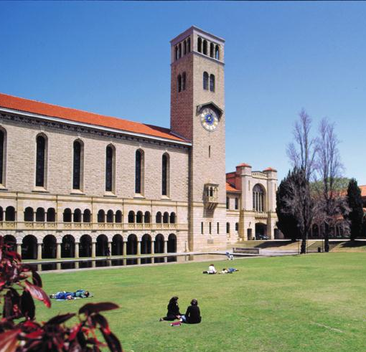

Slide 18
The Matariki Network: Partnerships for the Student Experience Professor Jane Long Pro Vice-Chancellor (Education)

Slide 19
What are the identified imperatives? How are they being pursued? (2 initiatives) What value do they add?

Slide 20
Rationale: The student experience is part of the core mission of all partners Good student experience-- educational, cultural, social– is a vital contributor to student retention, learning engagement, and academic success Similarities between partners allow us to exploit synergies in areas including internationalisation, exchange good practice, and build micro-networks via secondment etc.

Slide 21
Initiative 1: Student Wellbeing

Slide 22
Durham meeting of Student Services Directors, September 2011 Key themes identified for further action: 1. Student health: alcohol use 2. Student mental health and disability issues 3. Support for student associations 4. Social media and communication with students 5. The agenda to widen student participation to include more low SES students

Slide 23
Initiative 2: The Matariki Undergraduate Research Network (MURN)

Slide 24
MURN Underpinnings All participants (Durham, Otago, UWA, Queens) have strategic commitments to key educational trends worldwide, including: Promoting the nexus between teaching and research Promoting research within undergraduate education Advocating internationalisation, including ‘internationalisation at home’ (e.g. Paulo Santiago, 2008) Developing students’ awareness and capacity to operate effectively and ethically in global contexts

Slide 25
Examples: UWA’s Educational Principles state that students will, through their study, “gain the international knowledge, perspectives and sensitivities necessary to participate in a globalising world.” Otago University students will develop “an appreciation of the global perspective in their chosen discipline(s),and an informed sense of the impact of the international environment on New Zealand and New Zealand's contribution to the international environment”.

Slide 26
Project specifications: 6 month student project on a topic of strategic importance (2012, Internationalisation) Students work in groups via web technologies to network and share research findings They are trained locally and globally in educational research methods, and are supervised locally A group project is produced and presented

Slide 27
Outcomes: Development of research, oral and written communication skills Some will present in person at the main Matariki international research symposium All exchange information and understandings of their cultural backgrounds, differences and interests Friendship and curiosity as precursor to Study Abroad, exchange

Slide 28
Value and challenges: Contributes to internationalisation at home Low cost, low risk compared with some other forms Student publications Develops new but authentic links between staff within the network Managing time zones for the project Pilot will reveal more about capacity: labour intensive for staff in early stages

Slide 29
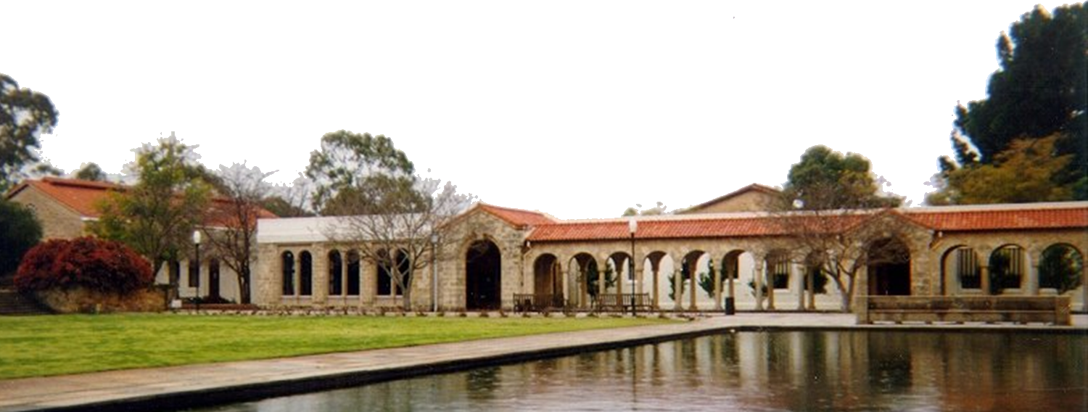
Thank you

Slide 30
Speaker Three
Professor Lindsay Whaley, Associate Provost of International Affairs, Dartmouth College, USA

Slide 31
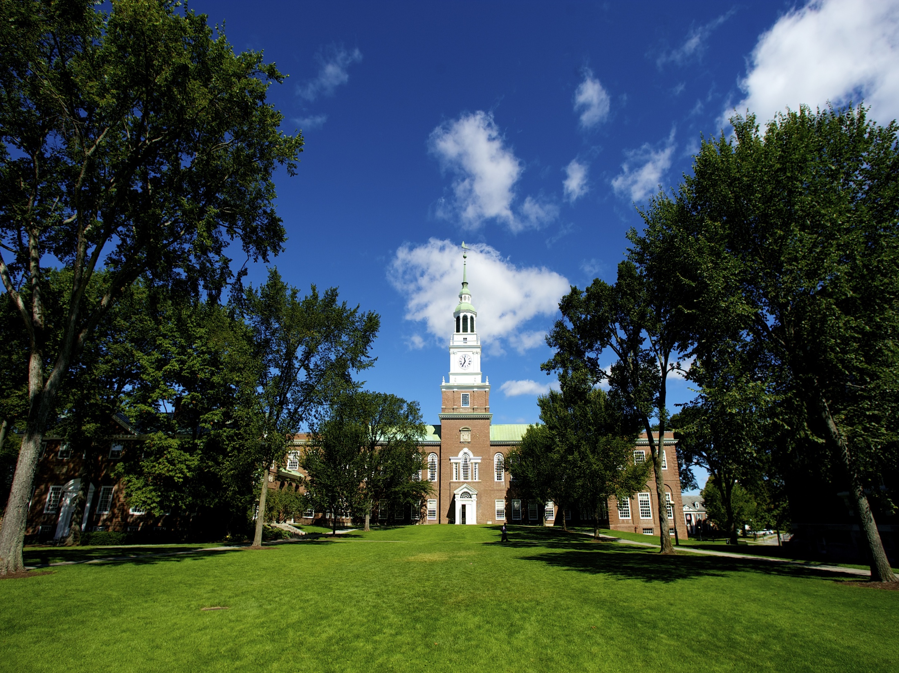
Curriculum Building in the Matariki Network
Lindsay Whaley
Associate Provost for International Affairs

Slide 32
MNU provides opportunities for curricular innovations in several ways:
-An international component can be added to areas that have lacked it
-Small departments become larger through collaborations
-Sharing of ideas naturally leads to curricular reform

Slide 33
Internationalization
Example: Sustainability Studies
-Typically involves some courses looking at global issues, but not courses from different regional perspectives
-Typically does not involve a travel component

Slide 34
Internationalization
Transatlantic Masters in Sustainability Studies
-Comparative orientation (Germany, US, Canada, others?)
-Include modules at different MNU campuses

Slide 35
“Growing” Departments
Example: German Studies
-Declining language enrollments over the past two decades have led to a decrease in German Studies faculties
-Smaller faculties have led to fewer courses, fewer study abroad options, gaps in research expertise

Slide 36
“Growing” Departments
Collaborations among MNU Departments
-Shared study abroad programs
-Faculty exchange on a regular basis
-Jointly-hosted seminars

Slide 37
Curricular Assessment/Reform
-Successful academic programs can ossify over time
-External reviews tend to benchmark and share best-practices from a national, rather than international, perspective

Slide 38
Curricular Assessment/Reform
E.G.: Peace and Conflict Curriculum Workshop
-prompted redesign of several Dartmouth courses/inclusion of video-conferencing with MNU faculty
-MNU members plan to do external review, benchmarking and assessment for each other

Slide 39
The Matariki Network of Universities – A small but beautiful view of partnering for a better world
Questions?
www.international.uwa.edu.au/aiea-conference-2012

