Slide 1
Strategic Partners: Integrating the Global Vision
Welcome to Strategic Partners: Integrating the Global Vision
02/22/12

Slide 2
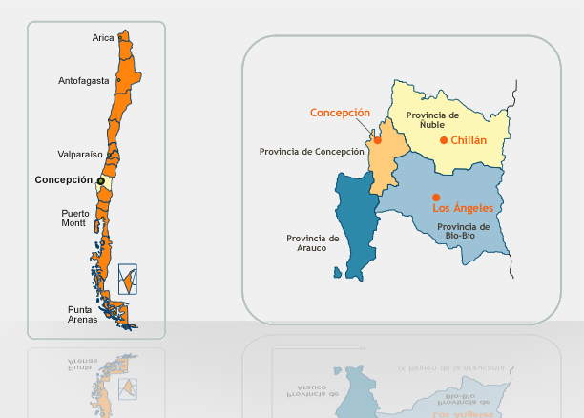
Universidad de Concepción: Where we are

Slide 3
Universidad de Concepción
Genesis of program
Faculty initiatives
Search for appropriate partner institution
Site visit
Development of program
Purposes of program
Accommodating changing institutional priorities
Evolving consultative processes
Outcomes of program
Strategic partnership across disciplines
Increasing attractivness to external partners (e.g. health care institutions)

Slide 4
What Makes a Partnership “Strategic”
Scope
Multidisciplinary
Multimodal
Sustainability of programs
Trust
Engagement of senior administrators
Awareness of value of partnership
Crisis management
Ability to adjust to intra- and inter- university circumstances
Create liminal field for interaction

Slide 5
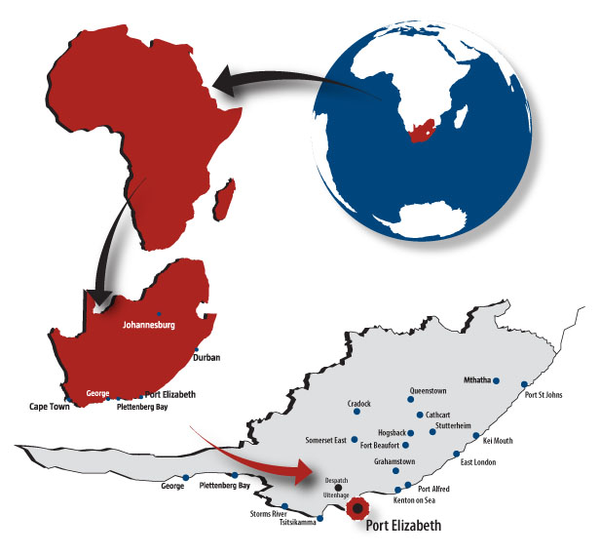
NMMU Where we are

Slide 6
The Nelson Mandela Metropolitan University
It’s a place of excellent teaching with a vibrant community that equips
students for life.
Our vision as a value-driven university is to be the leader in optimising the potential of our communities towards sustainable development in Africa.
Having attained our vision we will be able to:
- contribute to the transformation and development of our communities in
terms of the full spectrum of their needs.
- empower our institution, staff, graduates and communities to contribute
and compete, both locally and internationally.
- continue to make a major contribution to sustainable development in Africa

Slide 7
St Cloud – Strategic Partnership
Time
Trust
Collegial
Strategic

Slide 8
NMMU – Partner Network
Theory behind it.
You are part of the partnership network – how do we maximize it to practice ‘real time internationalization’
New partnerships.
The network is more than just a social meeting of friends
Promote internationalization amongst each other.
Focused discussion of Higher Education Internationalization
A meeting of South – North partners
Internationalization of our own environment
Developing a support network to assist each other in times of need.

