Slide 1
The Life Cycle of an International Student
Michael Drish mike.drish@vanderbilt.edu
Senior Asst. Director of Undergraduate Admission
Vanderbilt University
Wesley Teter wteter@educationusa.info
Regional Director, India and Central Asia, EducationUSA
Diane Weisz Young youngdw@state.gov
Program Officer, EducationUSA, U.S. Department of State
February 20, 2012

Slide 2
Outline for Session
Circular nature of successful life cycle for international students
Best practices for a campus where international students thrive academically and personally
Ways to enhance the life cycle of international students
Discussion

Slide 3
Life Cycle for International Recruitment
International Students
Recruit
Admit
Retain
Notes:
Think back to science classes in middle school as we consider the concept of an on-going life cycle for international students. By this we mean all students, not one individual. All three aspects of presented here – recruit, admit and retain – must be in strategically planned in order to program to succeed.

Slide 4
RETAIN
Orientation program
Culturally competent staff
Service that support students at all stages
Students at school that is good fit
Upon graduation, international alumni will want to assist with recruitment
Notes:
I’m starting with retain, b/c it’s essential that your campus be able to support the international students who attend your institution.

Slide 5
RECRUIT
Meet interested international students
Increase visibility on global scale by connecting with EducationUSA
Promote your institution via web & social media
Involve international alumni and/or parents
Use international travel effectively

Slide 6
ADMIT
Have clear standards
Provide easy access to information on your website (Is it internationally friendly?)
Respond quickly to your prospects
Include EducationUSA’s
Pre-Departure Orientation information in admit letters

Slide 7
Best practices and challenges to providing a campus where international students thrive academically and personally

Slide 8
Student-to-faculty ratio
Average class size
Overall satisfaction
Selectivity
Branding and
Net tuition per student
Giving Back
Reputation
Alumni Interaction
Job placement rate
Need / Merit Aid
Academic Life
Intellectual Growth
New FY, Transfer, & Readmits
Undergraduate Experience
Graduating Seniors
Global
Understanding
Personal Development
Student Life
Demographics
4, 5, 6-yr. grad. rates
Placement rate: grad & prof. sch.
Market share
Attrition
Discount rate
Student loan debt
Retention Rates – Why are students leaving?
Who is leaving - minority, high revenue, under prepared, etc.

Slide 9
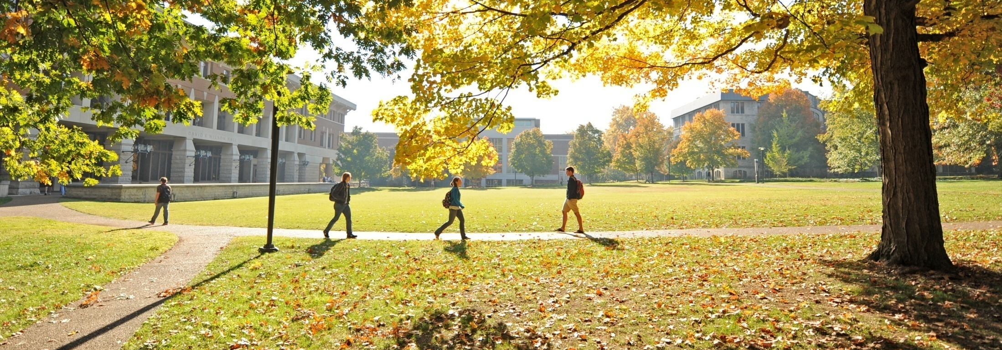
What matters to your international student?
Interconnectedness.

Slide 10
Is your campus functional but not meeting all international student needs?
Recruitment and Admissions
Academic Services
Curriculum and Instruction
Student Services
Financial Aid

Slide 11
Are your institutional factors working together to ensure int’l students thrive?
Recruitment and Admissions
Financial Aid
Academic Services
Student Services
Curriculum and Instruction

Slide 12
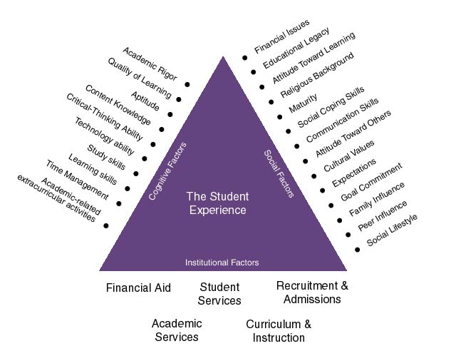
Three Forces acting on the Int’l Student Life Cycle

Slide 13
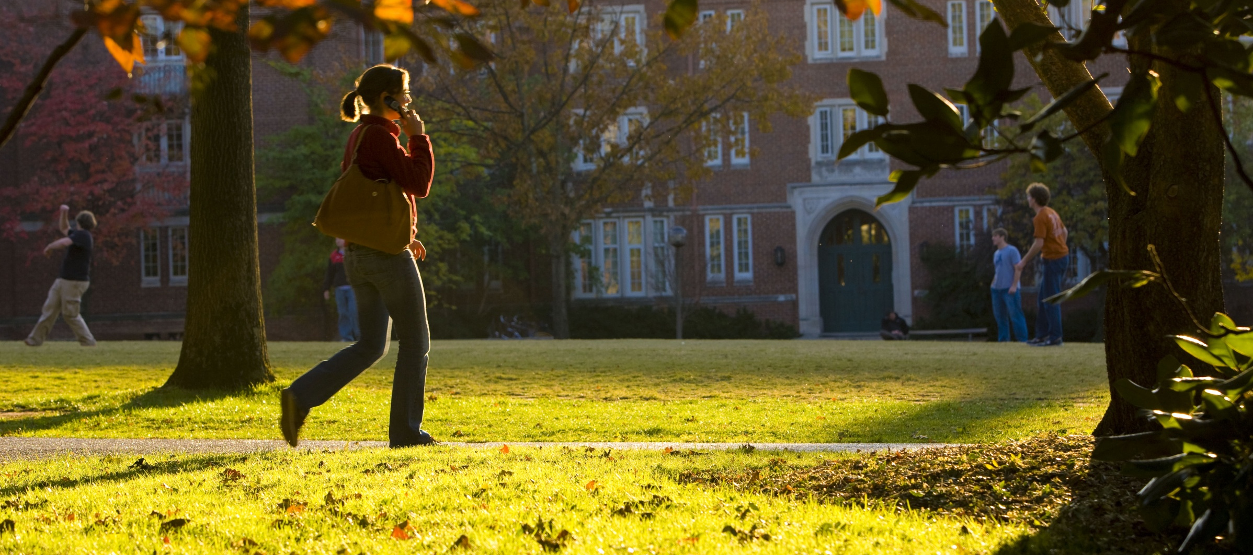
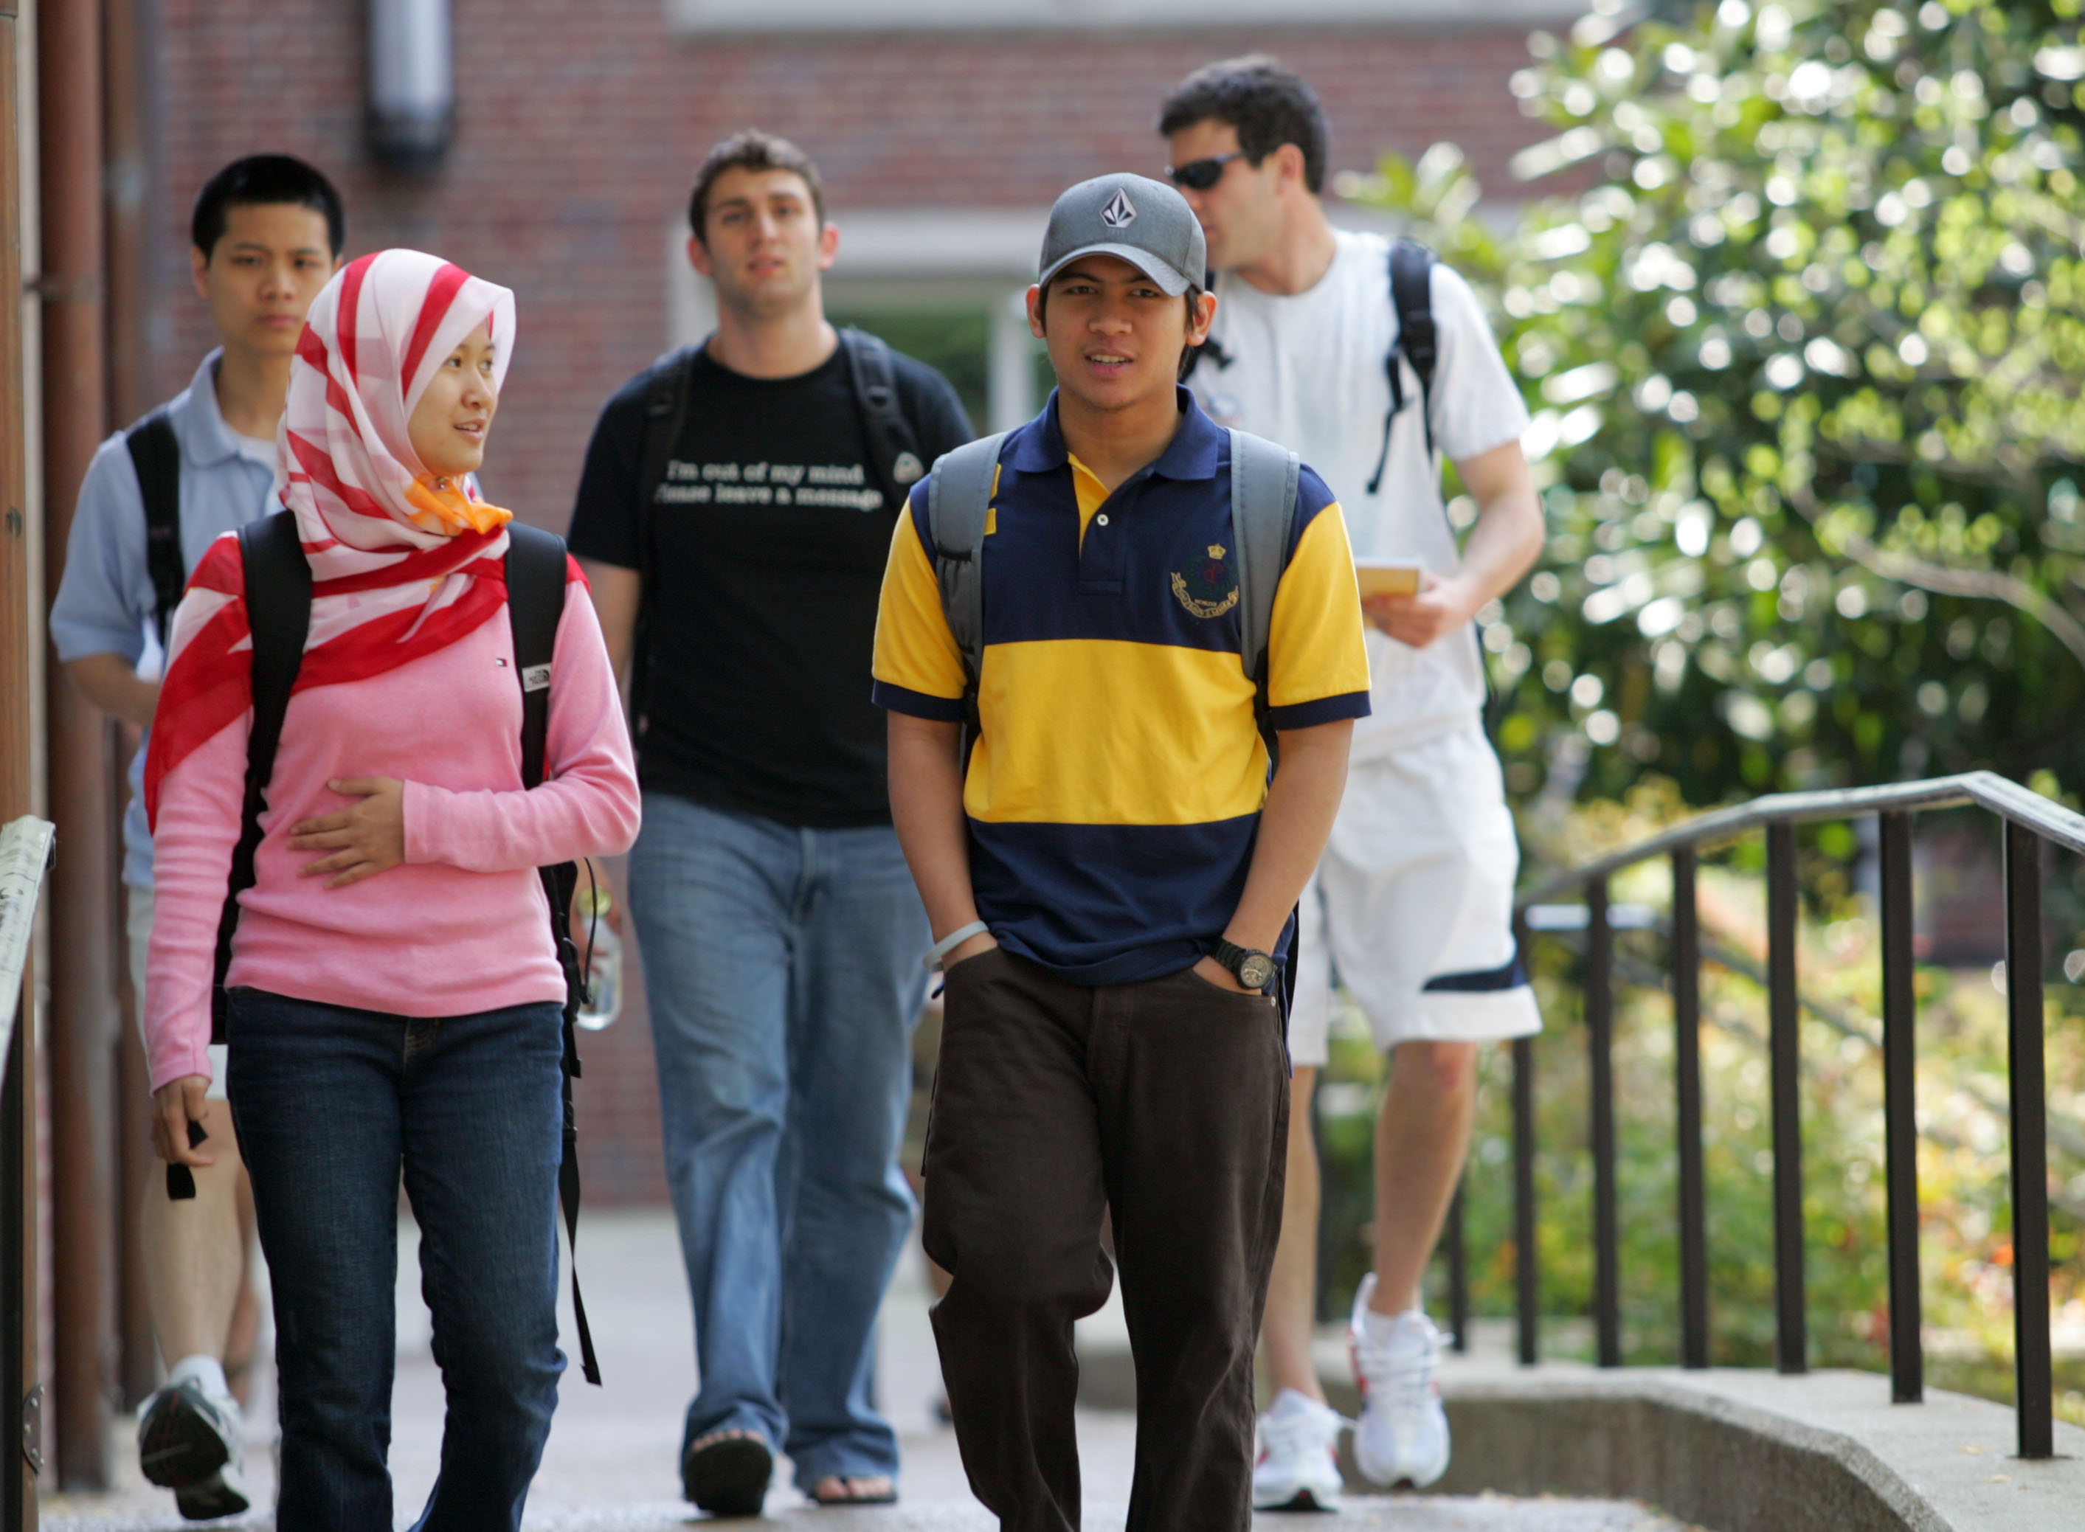
How the three forces can help ensure a successful int’l student life cycle
Ideally the three forces should exert the same level of force or presence to ensure a successful int’l student experience
Institutional Research can be a great mediator among the institutional factors
The more effective a university is at identifying prospective students who are a fit with the institution, the better prepared the university community will be to assist those enrolled students

Slide 14
Challenges to ensuring a successful international student experience
Social Factors
What happens if admissions is so divested from the undergraduate experience recruiters are misrepresenting the university social setting?
Cognitive Factors
How does an institutional prioritizing financial incentive as opposed to cognitive skills in the admissions process impact a successful international student experience?
Institutional Factors
Are all offices informing each other, and if not, how does that impact the international student?

Slide 15
Recruitment Trends & Opportunities
“It is so refreshing not having to specialize straight away, and instead, experiment with subjects I have never studied before.”
- British student at
UPenn
Notes:
What attracts students from other countries to study in the U.S.?
What course of study do they intend to pursue?
Do they prefer the U.S. to other key destinations?
What are the perceived barriers facing students who wish to study in the U.S.?

Slide 16
Who goes where and why?
- MACREADY & TUCKER (April, 2011)
Notes:
Why students move –
New Pull Factors from IIE:
High-quality study opportunities
Specialized study opportunities
Courses offered in a language mobile students speak or want to learn
Traditional links and diasporas
Affordable cost
Internationally recognized qualifications (rankings of individual schools)
Good prospects of high returns
Post-study career opportunities in destination country
Good prospects of successful graduation within a predictable time
Effective marketing by destination country/institution
Home country support for going there to study
Helpful visa arrangements, both for study and for work while studying
MACREADY & TUCKER (April, 2011)
Quality, reputation & breadth of US HE system
American campus life
Liberal arts, flexibility & focus on undergrad teaching
Internationalise their CVs
Cost & availability of funding
How we track and retain talent will depend on our ability to identify talent and communicate effectively about institutional fit.
We need a common framework to help recruit and track your leads and share our trends (Facebook “Insights” and EdUSA Weekly Update).
Government exists to serve your needs. Data and impact assessments about the life cycle of international talent are kingpins of collaboration and program development.

Slide 17
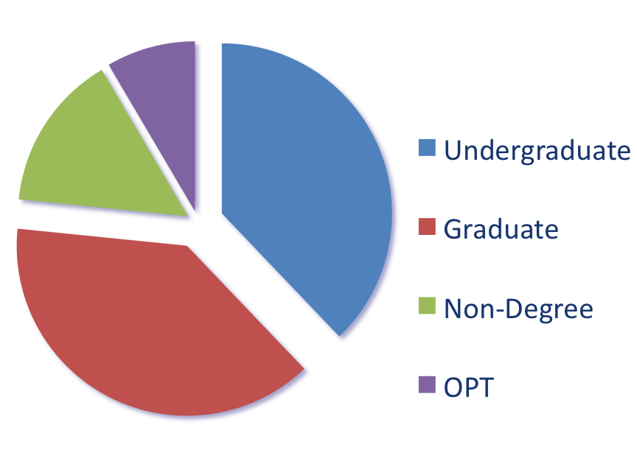
Europe-U.S. Student Mobility
77%
are degree-seeking
Source: IIE Open Doors
Notes:
More than 85,000 students from Europe/Eurasia a year choose the U.S. — 77% of whom come for full degree programs. Campus life and the range of study opportunities fuel a renewed enthusiasm for higher education overseas.

Slide 18
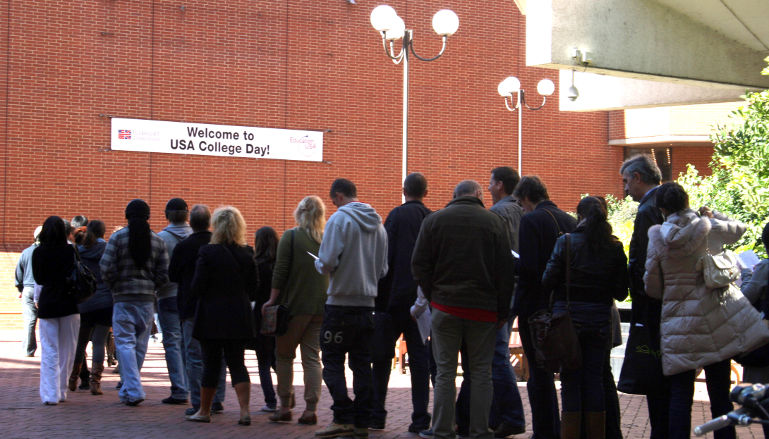
Changing Landscape in UK Higher Education
Notes:
Data from new attitudinal survey of 1,600 UK students released this week
The cultural experience was the main reason cited for wishing to study overseas (78 percent of respondents), followed by preparing for a future career (52 percent) and making professional contacts (36 percent).
Cultural experience was the main reason cited (78%)
To prepare for a future career (52%
Making professional contacts (36%).
6.5% limited places at UK universities (1/6 of prospective undergrads)
Data from new attitudinal survey of 1,600 UK students released this week
77% for the cultural experience
54% to enhance their CVs
47% the quality of academic programmes overseas
15% rising tuition at UK universities (1/3 of prospective undergrads in survey)

Slide 19
So why do UK students study abroad?
77%
“for the cultural experience…”
Alexandra Latham, Arizona State University
Notes:
19
Data from new attitudinal survey of 1,600 UK students released this week
77% for the cultural experience
54% to enhance their CVs
47% the quality of academic programmes overseas
15% rising tuition at UK universities (1/3 of prospective undergrads in survey)
6.5% limited places at UK universities (1/6 of prospective undergrads)

Slide 20
EdUSA Outreach Contacts
46,000 March 2011 - January 2012
314,876 October 1, 2010 – January 31, 2012
Outreach schools & universities

Slide 21
Who goes where and why?
Pull Factors:
Specialized study opportunities
Internationally recognized qualifications (& rankings)
Courses offered in a language mobile students speak or want to learn
Affordable cost (funding opportunities)
Effective marketing and timely communication
- MACREADY & TUCKER (April, 2011)
Notes:
Why students move - finding an academic program they can’t get at home
High-quality study opportunities
Specialized study opportunities
Courses offered in a language mobile students speak or want to learn
Traditional links and diasporas
Affordable cost
Internationally recognized qualifications (rankings of individual schools)
Good prospects of high returns
Post-study career opportunities in destination country
Good prospects of successful graduation within a predictable time
Effective marketing by destination country/institution
Home country support for going there to study
Helpful visa arrangements, both for study and for work while studying
MACREADY & TUCKER (April, 2011)
Push factors in the UK – capacity at home

Slide 22
Discussion

Slide 23
Scenario #1
Your mid-size private institution has always attracted a
substantial number of international students, nearly 3%.
In the past five years, your recruitment in China has
been tremendously successful. Your president is
delighted and wants to see these enrollment numbers
continue. As the dean of admissions and enrollment,
you think a more diverse population is better for your campus.
What are the benefits and challenges to having substantial
international populations from one or two countries?

Slide 24
Scenario #2
Your institution is relatively new to the field of international recruitment and wants to proceed strategically as you building your international student population. Right now you have limited services; however, a financial commitment has been made to campus internationalization. You’re not sure how to begin.
How do you gather data? How do determine which markets to explore?
Notes:
Most strategists suggest that a yields in a new country/market take three years.

Slide 25
Scenario #3
The leadership of your small private school is
committed to providing a quality educational experience
for the international students who decide to attend your
college in a small town in the Mid-west. Getting staff
beyond international admission and international student
services on board has been a struggle, in some but not all
cases. You need to develop a plan to prepare all staff to
work with international students. You also have heard
that international students have had bad, un-welcoming
experiences in town, too.
How would you approach these problems?

Slide 26
The Life Cycle of an International Student
Michael Drish mike.drish@vanderbilt.edu
Senior Asst. Director of Undergraduate Admission
Vanderbilt University
Wesley Teter wteter@educationusa.info
Regional Director, India and Central Asia, EducationUSA, Institute for
International Education
Diane Weisz Young youngdw@state.gov
Program Officer, EducationUSA, U.S. Department of State
February 20, 2012

