Slide 1
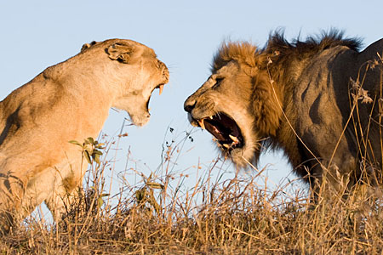
The Lions Roar:
The Progress and Potential of Sub-Saharan Africa

Slide 2
Panel and Discussion
Overview of Sub-Saharan Africa
Clara Priester - EducationUSA Regional Director - East and Southern Africa
Africa and . . .
Kennesaw State University
Dr. Daniel Paracka– Director of Education Abroad
Michigan State University
Dr. Jeffrey M. Riedinger– Dean of International Studies and Programs
Bryn Mawr College
Dr. Susan Sutton- Senior Advisor for Internationalization
EducationUSA

Slide 3
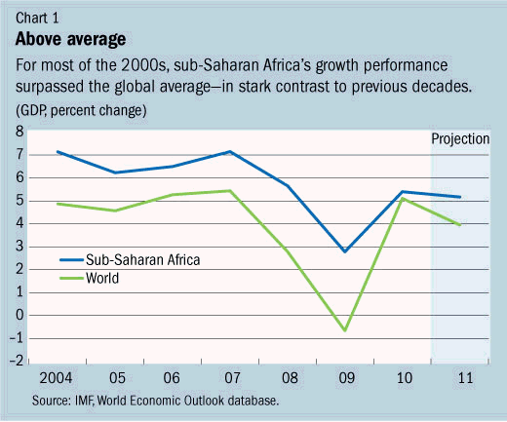
Favorable Trends
Sub-Saharan Africa economy grew by +5% in 2011
Expected to grow by +5.5% in 2012.

Slide 4
Favorable Trends
Over the past decade, six of the world’s ten fastest-growing countries were African.
In eight of the past ten years, Africa has grown faster than East Asia, including Japan.
According to Standard Bank, Africa now has a fast-growing middle class
Around 60 million Africans have an income of $3,000 a year, and 100 million will in 2015.
Notes:
Over the past decade six of the world’s ten fastest-growing countries were African.
In eight of the past ten years, Africa has grown faster than East Asia, including Japan.
Even allowing for the knock-on effect of the northern hemisphere’s slowdown, the IMF expects Africa to grow by 6% this year and nearly 6% in 2012, about the same as Asia.

Slide 5
Favorable Trends
Skills are improving: productivity is growing by nearly 3% a year, compared with 2.3% in America.
The rate of foreign investment has soared around tenfold in the past decade.
Africa’s enthusiasm for technology is boosting growth.
Notes:
Skills are improving: productivity is growing by nearly 3% a year, compared with 2.3% in America.
The rate of foreign investment has soared around tenfold in the past decade.
Africa’s enthusiasm for technology is boosting growth.

Slide 6
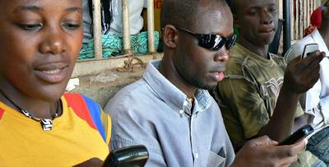
Favorable Trends
Africa has more than 600 million mobile-phone users—more than America or Europe.
Advances in communications, with mobile banking and telephonic agro-info . . .
a huge boon.
Around a tenth of Africa’s land mass is covered by mobile-internet services—a higher proportion than in India.
Notes:
Africa’s enthusiasm for technology is boosting growth. It has more than 600m mobile-phone users—more than America or Europe. Since roads are generally dreadful, advances in communications, with mobile banking and telephonic agro-info, have been a huge boon. Around a tenth of Africa’s land mass is covered by mobile-internet services—a higher proportion than in India.
Major companies investing
Facebook launched African language versions; and offering free mobile access in many parts of Africa
Google recently announced that Android Market will increase consumer access and developer support for paid applications in several new countries including 26 African countries
Google is experimenting with voice-activated e- mail and web search applications for African language speakers

Slide 7
Favorable Trends
Over the long term, Africa is well positioned . . .
a young population,
a growing labor force, and
an ability to tap into the growth centers in the world.
Over the last 10 years African trade has shifted dramatically.
More than half of African trade is with new partners, mainly with emerging markets.
Allows African countries to create new opportunities, to increase both trade and economic growth

Slide 8
The Downside – an Opportunity
Most countries lack the capacity and resources to address growing needs and demands for quality tertiary education
Many quality students will not have access to study further
Only 6% of Africa’s tertiary level students are able to access higher education services, compared to a global average of 26%. UNESCO 2010

Slide 9
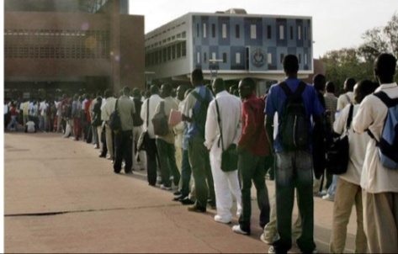
Push and Pull Factors
Africa students the most mobile in the world:
1 out of 16 students continue tertiary education outside of country of residence.
"Enrollments in higher education have expanded by 8.7 percent annually, compared to 5.1 percent for the world as a whole, and have tripled since 1991 to almost 4 million students.” World Bank
Notes:
Due to the 1970’s prioritization of primary education at the expense of higher education, today many countries are faced with large numbers of students seeking tertiary education opportunities which they don’t have the capacity to handle.

Slide 10
Push and Pull Factors
Access to better training
Wide range of schools and programs
Higher local and international value and recognition of degrees
Desire to study in English
High quality U.S. education system

Slide 11
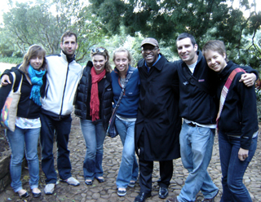
U.S. Study Abroad in Africa
Africa fast becoming one of the preferred alternative destinations for U.S. students
+15.5% growth, 2nd highest global destination increase
2008/09 11,844 students +4.5%
2009/10 13,681 students +5.3%
Source: Open Doors
Notes:
U.S. students who study in South Africa for a year. Picture from Pretoria U.S. Embassy

Slide 12
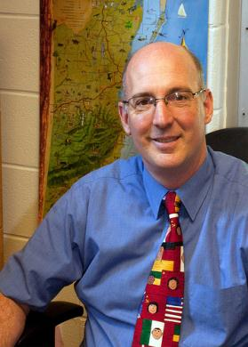
Dr. Daniel Paracka
Director of Education Abroad Kennesaw State University

Slide 13
Study Abroad to Africa: How has it Changed and Implications for Program Providers
Historical Context:
Early origins of U.S./Africa University partnerships
SA to Africa was largely the purview of elite area studies programs/graduate students
Africa was little understood
African academy was young
Negative stereotypes that persist today loomed even larger 30-40 years ago

Slide 14
Number of U.S. Students Studying in Africa

Slide 15
Percent of U.S. Students Studying Abroad in Africa
If we divide the 270,604 students that the IIE Open Doors Report said studied abroad for credit in 2009-2010 by the 20 million students attending U.S. universities, then only 1.35% are studying abroad and less than one tenth of one percent studied in Africa.

Slide 16
Study Abroad to Africa: How has it Changed and Implications for Program Providers
Today’s Context:
Many different types of students from many different types of colleges and universities
Going for shorter periods of time
African universities are much stronger and are generally well-prepared to host students
African Studies has matured – today most US colleges and universities offer numerous courses on Africa and there are innumerable studies/materials available to students to help them prepare in advance

Slide 17
Study Abroad to Africa: How has it Changed and Implications for Program Providers
What do students learn?
They learn about themselves
About Race – especially as a visible minority
About cultural heritage & about African perceptions of African-Americans
About different worldviews and value systems of local cultures, about diversity within Africa
About global issues of power and privilege, gender equality, social justice, sustainable development, modernization, etc..

Slide 18
Study Abroad to Africa: How has it Changed and Implications for Program Providers
Best Practices/Implications for Today
Address & De-Bunk stereotypes in promotional materials
Involve African Studies and interdisciplinary perspectives
Ensure students are well-prepared and supported
Many different models – no one size fits all solutions
Engage diverse segments of society
Learn from local leaders about local issues and concerns
Include service-learning activities
Importance of Partnership, Reciprocity, Common Interests and Mutual Benefits (partnerships go beyond study abroad and international student recruitment)

Slide 19
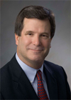
Dr. Jeffrey M. Riedinger
Dean of International Studies and Programs
Michigan State University

Slide 20
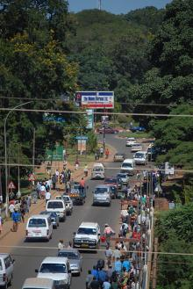
Transformative Program Goals
Deeper understandings of causes and solutions to poverty
Recognition of affluence and privilege in U.S. and global North
Awareness of self and of position as U.S. college students
Recognition of local people’s actions, empowerment, and agency in diverse circumstances

Slide 21
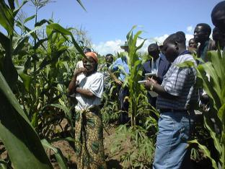
Thematic Goals
Students carry out research in NGOS to explore:
How roles and rights to resources are gendered in various ways across different contexts, including NGO offices and local communities
How problem identification takes place and how resources flow from donor headquarters to local communities in Malawi
How ideas of development may differ amongst communities, organizations, families, and women and men

Slide 22
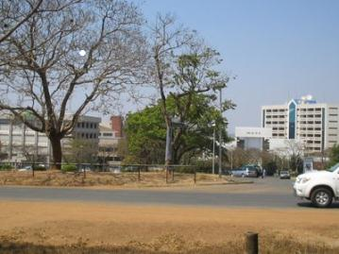
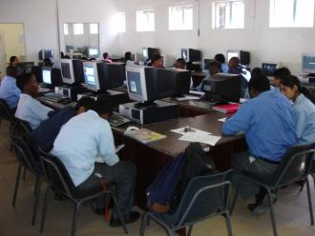
Program Structure
10-credit program, Summer Semester
4-credit classroom-based course in Malawi
6-credit internship with graded academic component
10 weeks total

Slide 23
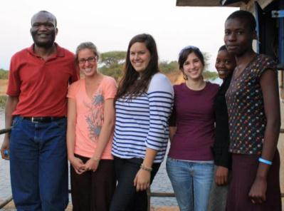
Academic Context
Interdisciplinary social
science course
General focus on Africa
Specific focus on Malawi
Daily course meetings
Lead Professor: MSU Geography Department faculty member from Malawi
Regular guest speakers from local universities and agencies; introductory language lessons
Integration of week-long field trip with course content

Slide 24
Partnered Internship Models
Student participants are placed in internships in pairs to encourage opportunities for discussion & reflection during & after the program. Two models:
1. U.S. students paired at international NGO in Malawi for 3 weeks & local community NGO for 3 remaining weeks
Opportunities for comparison of differing structures, activities & types of community level activities of two different organizations
2. U.S. students partnered with students at Bunda College of Agriculture in Malawi at NGOs for 6 weeks
Assistance with linguistic/cultural barriers
Work partnerships give students insights into each others cultures and experiences

Slide 25
Highlight on Internships
Students work full-time for six weeks in non-governmental organizations
Direct observation of & experience with NGO offices, activities, goals, & funding streams
Includes fieldwork in local communities
Academic assignment for internship credit
Observation of NGO structure & functions
Personal reflections on position as U.S. college students
Analysis of NGO’s approach to gender & development

Slide 26
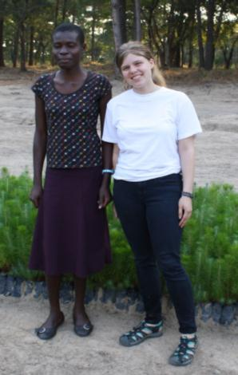
Student Outcomes
Participants report:
Change in career goals, with focus on:
Community development
International work
Sustainable agriculture
Deeper understanding of development
processes & gender issues as they play out in Malawi
Experiential understanding of
lifestyle differences & cultural issues
Access to mobility, global travel
Differential ability to access daily resources & needs

Slide 27
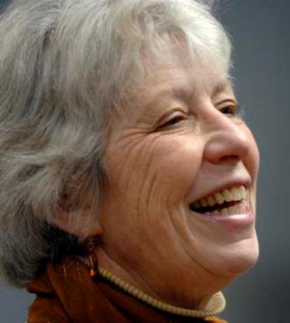
Dr. Susan Sutton
Senior Advisor for Internationalization
Bryn Mawr College

Slide 28
Rethinking Africa for Institutional Transformation
Recipient
Sender
Partner

Slide 30
STRATEGIC PARTNERSHPS
www.iupui.edu/~oia/IA/strategicpartnerships
Bi-national (or multinational) communities of higher education in which there is a constant flow of people, ideas, and projects back and forth, as well as the development of new projects and common goals.

Slide 31
Grew from small student exchange in 1989 to:
2 hospitals, 40+ clinics, 12 farms, craft workshop, orphanages, food distribution center
Treating 100,000 HIV/AIDS patients a year
Exchanging 20 faculty and 30 students annually
Projects in Education, Social Work, Liberal Arts, Law, Informatics, Engineering, Business, Nursing, Dentistry, Public Health, Tourism, Physical Education, Science, Water Management, Art, Journalism, SPEA
Engagement of dozens of community organizations in Indiana and Kenya
Over $100 million in grants

Slide 32
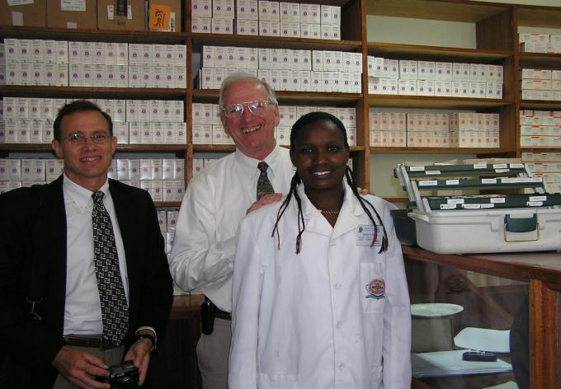
IUPUI and Moi University

Slide 36
Strategic Partnerships (1):
Enable faculty who know little about the partner country or have no international background to become involved
Build complex understandings and a sense of mutual responsibility that deepens over time
Impact student learning across the curriculum for both institutions
Spark joint research and development projects on new topics
Foster creative interdisciplinarity
Involve administrators & staff, too
Notes:
36

Slide 37
Strategic Partnerships (2):
Create economies of scale/synergies of effort
Establish defined concentrations of activity that attract external funding
Model the cross-national competencies we want for our students
Lead to community engagement on both sides
Build resources through sharing and collaboration
Last long beyond their original proposers
Notes:
37

Slide 38
Strategic Partnerships (3):
Stimulate flows of students even beyond the specific partnership
Establish a positive framework by which the growing number of African students in the U.S. are understood
Move all of us toward an interconnected global system of higher education, in terms of research, generation of new knowledge, and social impact

Slide 40
About EducationUSA Sub-Saharan Africa
50 countries, two territories
Four sub-regions: Central, East, West and Southern Africa
Divided according to predominant language of instruction
Anglophone (22 countries)
Francophone (19 countries)
Lusophone (5 countries)
Other (4 countries)

Slide 41
About EducationUSA Sub-Saharan Africa
49 EducationUSA Centers in 43 countries
380,000 contacts annually
Most Centers located in U.S. Embassies and Consulates
56 Advisers, 2 Regional Directors and 1 ECA Program Officer

Slide 42
African Students in U.S.
Notes:
Over the past 20 years, sub-Saharan African students in the U.S. have recorded a net gain of 62%, and a net gain of 23% over the past 10 years.

Slide 43
Top 10 African Countries

Slide 44
Africa: Levels of Study

Slide 45
Most Rapid Growth
. . . and countries that set all-time highs
recruitment opportunities
 | Country | # of Students | 2010/11 vs. 2009/10 | 5 Year Average
 | Angola | 690 | +14% | +66%
 | Burundi | 123 | +9 | +48%
 | Congo Brazzaville | 240 |  | *68%
 | Cote D’Ivoire | 904 |  | +38%
 | Gabon | 431 | +40% | +87%
 | Rwanda | 457 | +1.3% | +118%

Slide 46
2011 Destinations
Berea College
Yale
University of Kansas
University of California, Davis
St John’s College
Franklin College
Cottey College
Tufts University
Bates College
Smith College
Haverford College
Lynn University
Bryn Mawr College
Davidson College
MIT
Worcester Polytechnic Institute
Le Moyne College
Michigan State University
Harvard
Mt Holyoke College
Nazareth College
Berea College
University of Chicago
University of Pennsylvania
College of St Scholastica
Georgia College and State University
Jacobs University
Columbia University
Pomona College
Williams College
Wartburg College
Jacobs University
College of St Elizabeth
Liberty University
Oberlin College
Wooster
Kennesaw State University
Bryn Mawr
Stanford
Auburn
Bowling Green
Brandeis
Duke
Florida Institute of Technology
Henderson State
Wheeling
University of North Dakota
University of Louisville
Viterbo
Utah State University
University of Akron
Florida International University
Minnesota State University –Mankato
University of Colorado - Denver

Slide 47
U.S. Study Abroad: Leading Hosts
Country | # Students | % change
South Africa | 4,313 | +4%
Ghana | 2,132 | +5%
Kenya | 1,198 | +36%
Tanzania | 962 | +12%
Uganda | 571 | -7%
Senegal | 381 | -.8%
Zambia | 233 | +26%
Namibia | 226 | +27%
Botswana | 215 | +18%
Ethiopia | 191 | +44%

Slide 48
Partnering with Africa
Refer all African applicants to EducationUSA Advising Centers.
Encourage your alumni in Africa to get involved with college fairs, mentoring, student programs and other EducationUSA Center activities.
Conduct digital video conferences or Skype meetings with students through our Centers.
EducationUSA Centers in Africa provide key faculty development support — a top priority for Africa’s tertiary education systems.

Slide 49
Partnering with Africa
The majority of Advising Centers are located in U.S. Embassies and Consulates which provides direct and strong identification with the U.S. government — a plus in Africa.
We facilitate university linkages and faculty exchange programs, research ties, sabbatical placements, etc.
Join the EducationUSA Africa Facebook page: http://www.facebook.com/home.php?sk=group_159231440765069

Slide 50
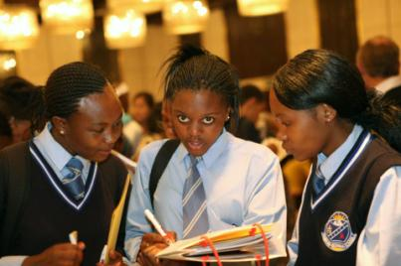
EducationUSA Website
Country specific information about College Fairs, DVC’s and other events and activities.
www.educationusa.state.gov

Slide 51
The Lions Roar:
Questions and Discussion

