Slide 1
Webster University
International Campus Network
February 2012

Slide 2
Webster University Mission Statement
Webster University, a worldwide institution, ensures high quality learning experiences that transform students for global citizenship and individual excellence.

Slide 3
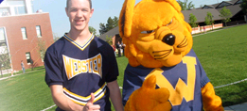
Facts
Founded in 1915
Home residential campus in Webster Groves, Missouri, a quiet residential suburb of St. Louis
Approximately 3,300 undergraduate students in St. Louis
Approximately 6,000 graduate students in St. Louis
Student Faculty Ratio 13/1
Average class size is 13
Maximum class size is 25

Slide 4
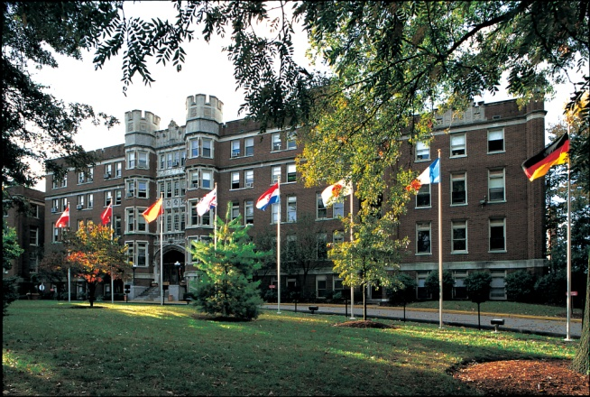
Facts
Five Schools and Colleges
Arts and Sciences
Walker School of Business and Technology
Communications
Education
Leigh Gerdine School of Fine and Performing Arts

Slide 5
Accreditations
Webster University is accredited by The Higher Learning Commission and is a member of the North Central Association, 312-263-0456, www.ncahlc.org.
International Recognitions
China: The Webster University MBA program, offered in partnership with the Shanghai University of Finance and Economics, is officially approved by and recognized by the Ministry of Education in China.
Thailand: Webster University in Thailand is an accredited, private university by the Thailand Ministry of Education under Thai law.
Austria: Webster University in Vienna is accredited by the Austrian Ministry for Education and Culture as a private university under Austrian law.
The Netherlands: Webster University in the Netherlands is accredited by the Netherlands-Flemish Accreditation Agency (NVAO) and is an approved institute of higher education under Dutch law.
Numerous Specialty Accreditations

Slide 6
Facts
Over 20,000 students worldwide
100 Campuses Around the World
Over 130 Nationalities Represented on the student body
Over 150,000 Living Alumni around the world
Campuses in Austria, China, the Netherlands, Thailand, Switzerland, the United Kingdom, the United States
Partnerships in Argentina, Hungary, Mexico and Slovakia
Dual Degree Program with Kansai University, Japan

Slide 7
Recognized Leader in International Education
International campuses spotlighted as part of the Paul Simon Award for Internationalization
Study abroad program recognized by the U.S. News and World Report America’s Best Colleges as one of the top “academic programs to look for”
Study abroad program recognized by the U.S. News and World Report America’s Best Colleges as a “top 100” University in the U.S.

Slide 8
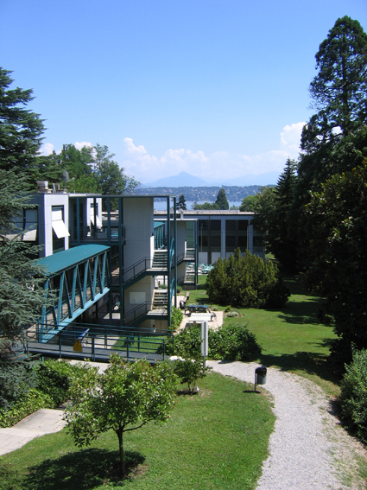
INTERNATIONAL CAMPUS HISTORY
Geneva, 1978
Vienna, 1981
Leiden, 1983
London, 1986
China, 1996
Thailand, 1999
Partnership Programs

Slide 9
Geneva
Celebrating 35 years
Only U.S. University operating undergraduate and graduate programs in Switzerland
Only residential University campus in the Geneva area
Enrolls students from over 123 countries around the world
Faculty members from 35 nations

Slide 10
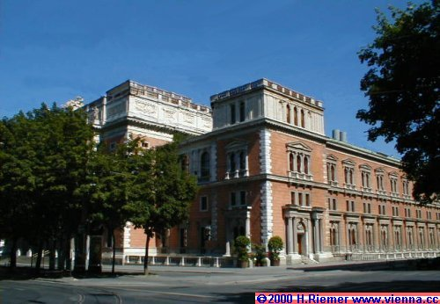
Vienna
Only university in Austria granting US and Austrian accredited degrees
Oldest provider of the MBA in Austria
Only U.S. University in Central Europe to offer MBA programs in Slovakia and Hungary in partnership with local universities

Slide 11
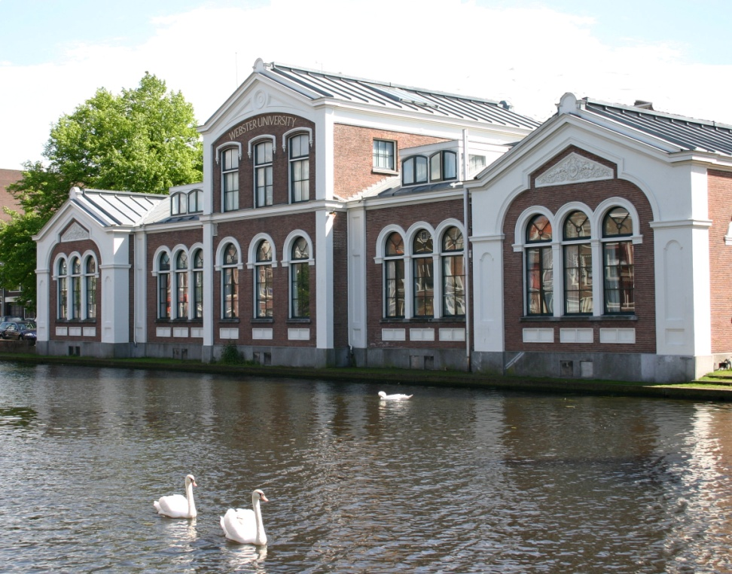
Leiden
Only U.S. University with Dutch Accreditation
Only U.S. University operating undergraduate and graduate programs in The Netherlands
Operating in both Leiden and Amsterdam

Slide 12
London
First and longest running American MBA program in the London
Collaborative Partner with Regent’s College
Largest provider of American masters’ degrees in the UK
Accredited by the British Accreditation Council

Slide 13
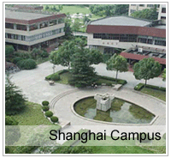
China
One of the first Joint MBA Programs in all of China
First approved Joint MBA in China's West region (Chengdu)
MBA in Shanghai and Chengdu
Undergraduate programs and Confucius Institute partnership with Beijing Language and Culture University

Slide 14
Thailand
Only US and Thai accredited University
Operates in both Cha’am and Bangkok

Slide 15
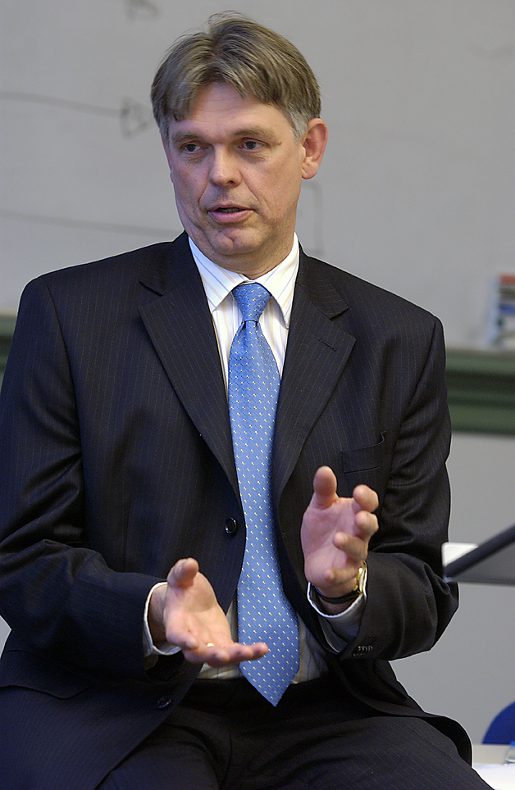
Faculty
Average faculty member on an international campus speaks 3 languages, has lived in 3 or more countries, and has had 3 or more careers
Sponsored more than one hundred (150) faculty on international exchange teaching and researching visits between and among the international campuses the past ten years.

Slide 16
Topics of Discussion
Start Up Issues
Financial, Legal and Regulatory Issues
Home U.S. Campus and International Campus Relations
Leading and Managing International Network of Campuses

Slide 17
Start Up Issues

Slide 18
Start Up Issues
Why start an international campus?
How does a University start an international campus?
How does one determine when to close an international campus?
Other

Slide 19
Financial, Legal and Regulatory Issues

Slide 20
Financial, Legal and Regulatory Issues
What is the legal and organizational form to the international campus?
What are the regulatory issues including local accreditation and control?
How to make an international campus operate within the University's financial framework?
What are the financial and resource challenges of operating an international campus?
Other

Slide 21
Home U.S. Campus and International Campus Relations

Slide 22
Home U.S. Campus and International Campus Relations
How does having an international campus fit within the University’s mission and vision?
How to take advantage of an international campus with regards to faculty, students and staff mobility?
How does a University ensure communications and decisions are as two-way and transparent as possible?
Other

Slide 23
Leading and Managing International Network of Campuses

Slide 24
Leading and Managing International Network of Campuses
How does one determine the academic identity of the international campus?
How does one ensure quality at the international campus?
How does one hire and evaluate leaders, faculty and staff for the international campus?
What are the possibilities of residential and student life at international campuses?
Other

Slide 25
OTHER QUESTIONS
What other burning questions do you have?

